Slide 1
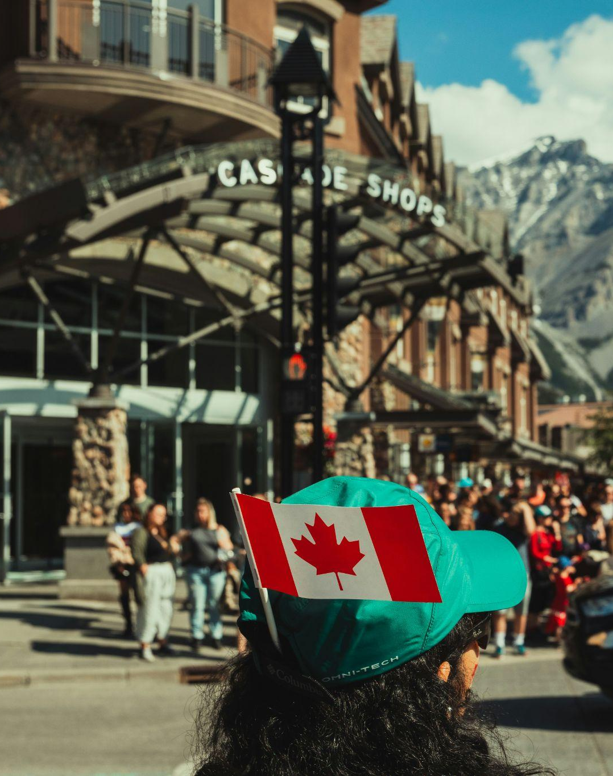
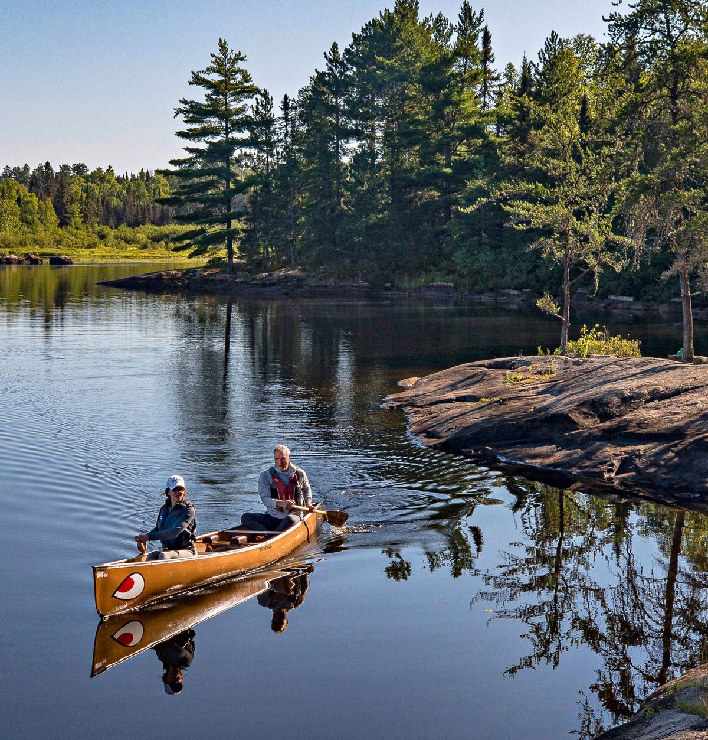



Tourism Narrative:
A Unified Voice
for Canada’s
Visitor Economy
TIAC 2025

Slide 2



CONTENTS
A. Project Approach
B. Key Audiences
C. Key Messages
D. Tourism Narrative Resources

Slide 3


PART A
Project
Approach

Slide 4
APPROACH
The Opportunity
CHALLENGE:
Fractured Messaging
Communication efforts across Canada’s tourism industry are fractured and inconsistent.
OPPORTUNITY:
Common Narrative & Platform
Clear, concise and consistent messaging across target audience groups is required to support an increased understanding of the cumulative benefits and contributions that our sector makes to Canada and its peoples at the local, regional, and national level.
→

Slide 5
APPROACH
Key Objectives
& Goals
GOALS
The objective of this project is to develop a compelling tourism narrative and key messages to reach target audiences, reflecting tourism’s true impact on Canada’s economy, society, and identity.
01 | Reframe the national narrative and drive pride for tourism
02 | Demonstrate tourism’s full value and build support for the sector
03 | Support policy alignment and strategic investment

Slide 6
APPROACH
A Comprehensive Review Process to Refine Messaging
01
Identify Audiences
Stakeholder Interviews
02
Research Audience Motivations
Audience Research, Audience Segmentation
03
Draft Messages by Audience
Narrative Workshop, Audience Segmentation, Narrative Development
04
Test Messages with Audiences
Narrative Matrix Testing & Feedback, Narrative Matrix Review
05
Key Messages & Narrative
Narrative Matrix Framework,
Implementation Guidelines
Identify Audiences
Research Audience Motivations
Draft Messages by Audience
Test Messages with Audiences
Key Messages & Narrative
Stakeholder Interviews
Audience Research, Audience Segmentation
Narrative Workshop, Audience Segmentation, Narrative Development
Narrative Matrix Testing & Feedback, Narrative Matrix Review
Narrative Matrix Framework,
Implementation Guidelines
1
2
3
4
5

Slide 7
APPROACH
Our Mission Statement
To elevate tourism as a unifying force for Canada’s prosperity, pride, and progress by delivering clear, compelling, and
common narratives that reflect the sector’s true economic, cultural, and societal value, empowering stakeholders across government, industry, and communities to advocate for, invest in, and benefit from a thriving tourism economy.

Slide 8

PART B
Key
Audiences

Slide 9

AUDIENCES
Key Audiences
Canadians ≤40
Residents under 40 years of age across all provinces and territories, representing diverse, cultural backgrounds, and socioeconomic conditions, as well as a predilection to value-based outlooks and digital fluency.
Federal Government
Ministers, MPs, deputy ministers, federal bureaucrats, and national agencies, including cross-party actors and key committees shaping national policy and funding.
Tourism Associations
Sector-specific associations from airports to hotels, restaurants to motor coaches, as well as partner organizations such as ITAC and Parks Canada.
Tourism
SMEs
Local operators, accommodations, guides, artisans, restaurants, transport providers, experience creators, and Indigenous businesses.
Investors
Developers, investment firms, private equity groups, hotel chains, and entrepreneurs who invest in tourism-related infrastructure, attractions, accommodations, and services.
Canadians 40+
Residents across all provinces and territories, representing diverse cultural backgrounds, and socioeconomic conditions. They tend to be more tax-conscious, local community minded and heritage focused.
Local Government
Provincial, territorial, municipal, and Indigenous leaders, economic development officers, regional planners, and public works departments.
DMOs
Destination Marketing Organizations at the local, regional, provincial, and territorial level.
Large Tourism Businesses
Airlines, chain hotels, casinos, attractions and entertainment providers, chain restaurants, real estate developers, construction firms

Slide 10

AUDIENCES
Canadians
Why they matter
ROLE IN TOURISM’S SUCCESS | Broad public understanding and support for tourism influence how elected officials prioritize the sector.
STRATEGIC RELEVANCE | Residents are hosts. Their perception of tourism’s benefits (or drawbacks) affects how welcome visitors feel and the industry’s long-term sustainability.
KEY OUTCOMES | Canadians themselves are a major market for domestic travel. Fostering pride and awareness of tourism’s value can increase local travel and spending, and advance Indigenous reconciliation.
INFLUENCE ON PERCEPTION | Canadians are influential amplifiers of stories via word of mouth, online sharing, and community engagement.

Slide 11
AUDIENCES
Canadians
01
Key Motivations
Quality of life benefits
Community pride, and shared cultural identity
Jobs and opportunities for friends and family
Affordable and accessible local experiences
02
Call to Action
Advocate for tourism locally
Support tourism policies and infrastructure investment
Travel within Canada
Advance economic reconciliation via Indigenous experiences
03
Main Channels
Social media
Local news and radio
Community events and festivals
Influencer partnerships
04
KPIs
Increased domestic travel
Improved resident sentiment

Slide 12
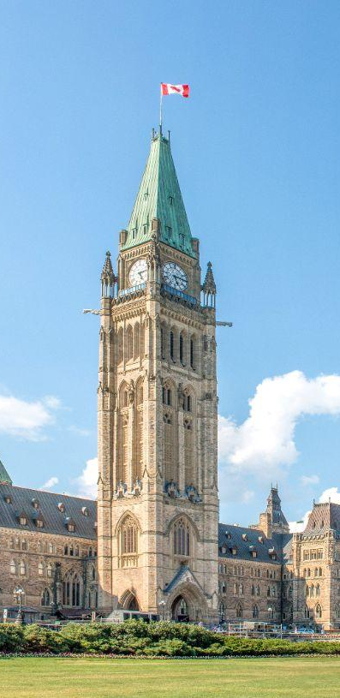
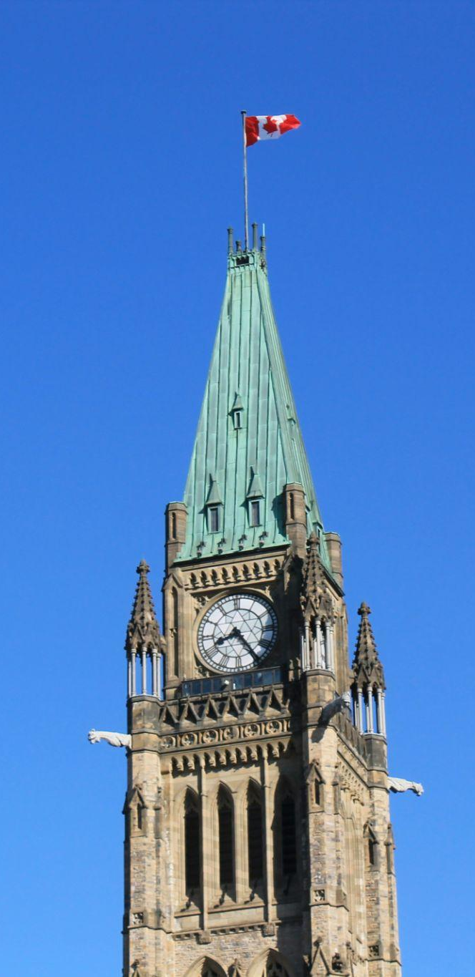
AUDIENCES
Federal Government
Why they matter
ROLE IN TOURISM’S SUCCESS | They set funding priorities, regulatory frameworks, and recovery strategies that can advance or hinder tourism development.
STRATEGIC RELEVANCE | Tourism intersects with many departments, government buy-in helps integrate tourism into broader planning.
KEY OUTCOMES | Clear messaging is needed to secure long-term support, especially during economic uncertainty or political shifts.
INFLUENCE ON PERCEPTION | Policymakers can amplify the tourism narrative in speeches, budgets, and strategic plans, reinforcing its legitimacy and importance.

Slide 13
AUDIENCES
Federal Government
01
Key Motivations
Economic growth, competitiveness, and national impact
Alignment with broader policy priorities
Riding-level wins and political capital
02
Call to Action
Integrate tourism into economic policy
Increase sector funding and strategic visibility
03
Main Channels
Advocacy meetings
Policy briefings & submissions
Parliamentary committees & consultations
Op-eds in policy outlets
04
KPIs
Policy references to tourism
Ministerial statements featuring tourism data

Slide 14
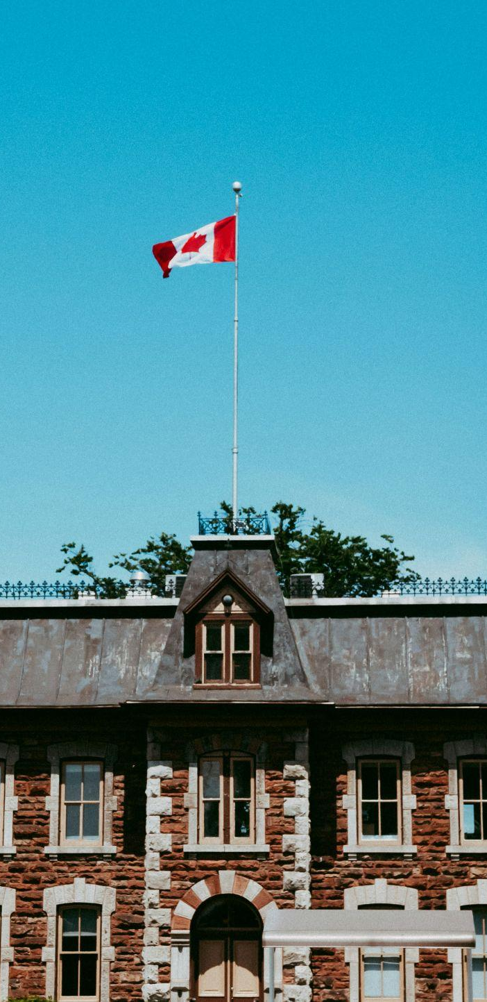
AUDIENCES
Local, Provincial & Territorial Government
Why they matter
ROLE IN TOURISM’S SUCCESS | Local and provincial governments fund, permit, and operate tourism infrastructure (e.g., cruise terminals, signage, parks).
STRATEGIC RELEVANCE | They shape zoning, land-use, and visitor management, and are often the most visible face of tourism policy.
KEY OUTCOMES | Local leaders can become tourism champions with the right tools.
INFLUENCE ON PERCEPTION | They translate national narratives into localized storytelling, events, and campaigns that reach residents directly.

Slide 15
AUDIENCES
Local, Provincial & Territorial Government
01
Key Motivations
Economic development, job creation, and regional pride
Visible results from investments
Community engagement and livability
02
Call to Action
Integrate tourism into regional planning
Promote and fund local and Indigenous tourism initiatives
Partner with Indigenous and non-Indigenous communities for shared messaging
03
Main Channels
Council briefings and municipal strategy docs
Local newspapers and newsletters
Federation of Canadian Municipalities (FCM) meetings
Provincial caucus events
04
KPIs
Tourism in economic development plans
Local campaign funding or infrastructure commitments

Slide 16

AUDIENCES
Tourism Associations & Partners
Why they matter
ROLE IN TOURISM’S SUCCESS | They convene stakeholders across the tourism ecosystem and can embed the narrative into industry dialogue and advocacy.
STRATEGIC RELEVANCE | They are the frontline advocates to government and media and need tailored narratives that align with evidence-based policy messaging.
KEY OUTCOMES | With newsletters, events, and social media channels, they help distribute messaging and ensure alignment across geographies and sub-sectors.
INFLUENCE ON PERCEPTION | Their deep industry insights ensure the messaging remains rooted in real-world challenges and aspirations.

Slide 17
AUDIENCES
Tourism Associations & Partners
01
Key Motivations
Sector unity and influence
Tools to support their members
Demonstrable impact from advocacy
Relevance and leadership
02
Call to Action
Champion the narrative to government, members and media
Coordinate consistent messaging across the ecosystem
Provide feedback and insight on adoption
03
Main Channels
Industry newsletters and member portals
Sector roundtables and conferences
National tourism summits
04
KPIs
Broad uptake of the narrative by member organizations
Narrative included in association advocacy materials

Slide 18

AUDIENCES
Destination Marketing Organizations (PT/DMOs)
Why they matter
ROLE IN TOURISM’S SUCCESS | DMOs control brand platforms, tourism campaigns, and visitor-facing content. The narrative matrix can enhance the consistency and relevance of their outreach.
STRATEGIC RELEVANCE | They often work between industry, government, and the public, making them pivotal in translating the narrative to multiple audiences.
KEY OUTCOMES | Many DMOs are shifting toward stewardship roles, and need storytelling that showcases tourism’s long-term benefits (e.g., sustainability, jobs, infrastructure).
INFLUENCE ON PERCEPTION | They’re well positioned to pilot narrative tools and help refine the messaging matrix before broader rollout.

Slide 19
AUDIENCES
Destination Marketing Organizations (PT/DMOs)
01
Key Motivations
Brand strength and
visitor growth
Community support
and trust
Operational alignment with partners
Tourism seen as a valued contributor locally
02
Call to Action
Integrate the narrative into destination branding
Share local proof points to enrich the national story
03
Main Channels
Industry and stakeholder updates
Sector roundtables and conferences
04
KPIs
Enhanced resident support metrics
Participation in national storytelling initiatives

Slide 20
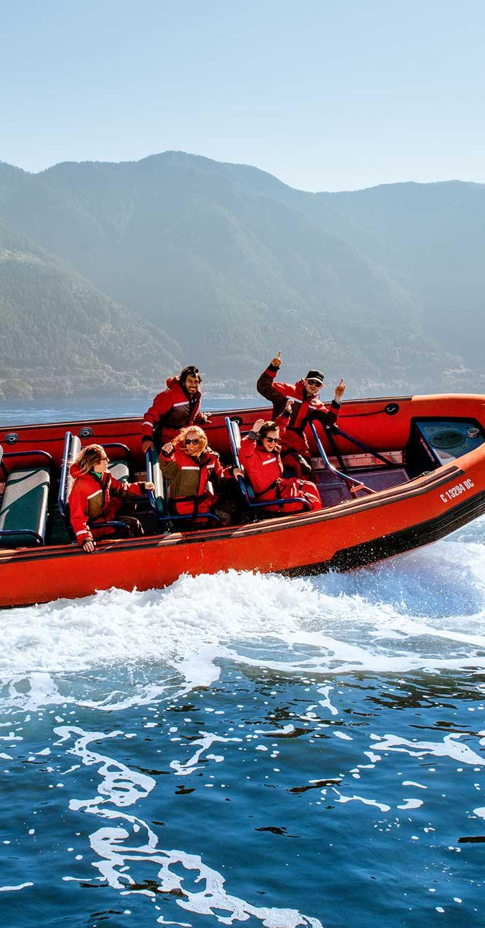
AUDIENCES
Tourism SMEs
Why they matter
ROLE IN TOURISM’S SUCCESS | SMEs represent the majority of tourism businesses in Canada and are essential to the sector’s employment and innovation.
STRATEGIC RELEVANCE | They are the face of Canadian tourism to most visitors and are natural carriers of the narrative through guest interactions.
KEY OUTCOMES | These businesses are often more sensitive to policy shifts and crises but are also key beneficiaries of targeted messaging, support, and recognition.
INFLUENCE ON PERCEPTION | If equipped with strong, cohesive narrative tools, they can help consistently communicate tourism’s value to residents and policymakers alike.

Slide 21
AUDIENCES
Tourism SMEs
01
Key Motivations
Profitability, visibility, and ease of doing business
Regulatory support and market access
Recovery and growth
02
Call to Action
Use messaging to advocate and promote their value
Participate in associations and community engagement
Collaborate on regional storytelling
Partner with Indigenous suppliers and creators; credit cultural knowledge
03
Main Channels
Email newsletters
Chamber of Commerce events
Trade shows and webinars
04
KPIs
Increased SME engagement in advocacy or associations
Use of messaging tools

Slide 22
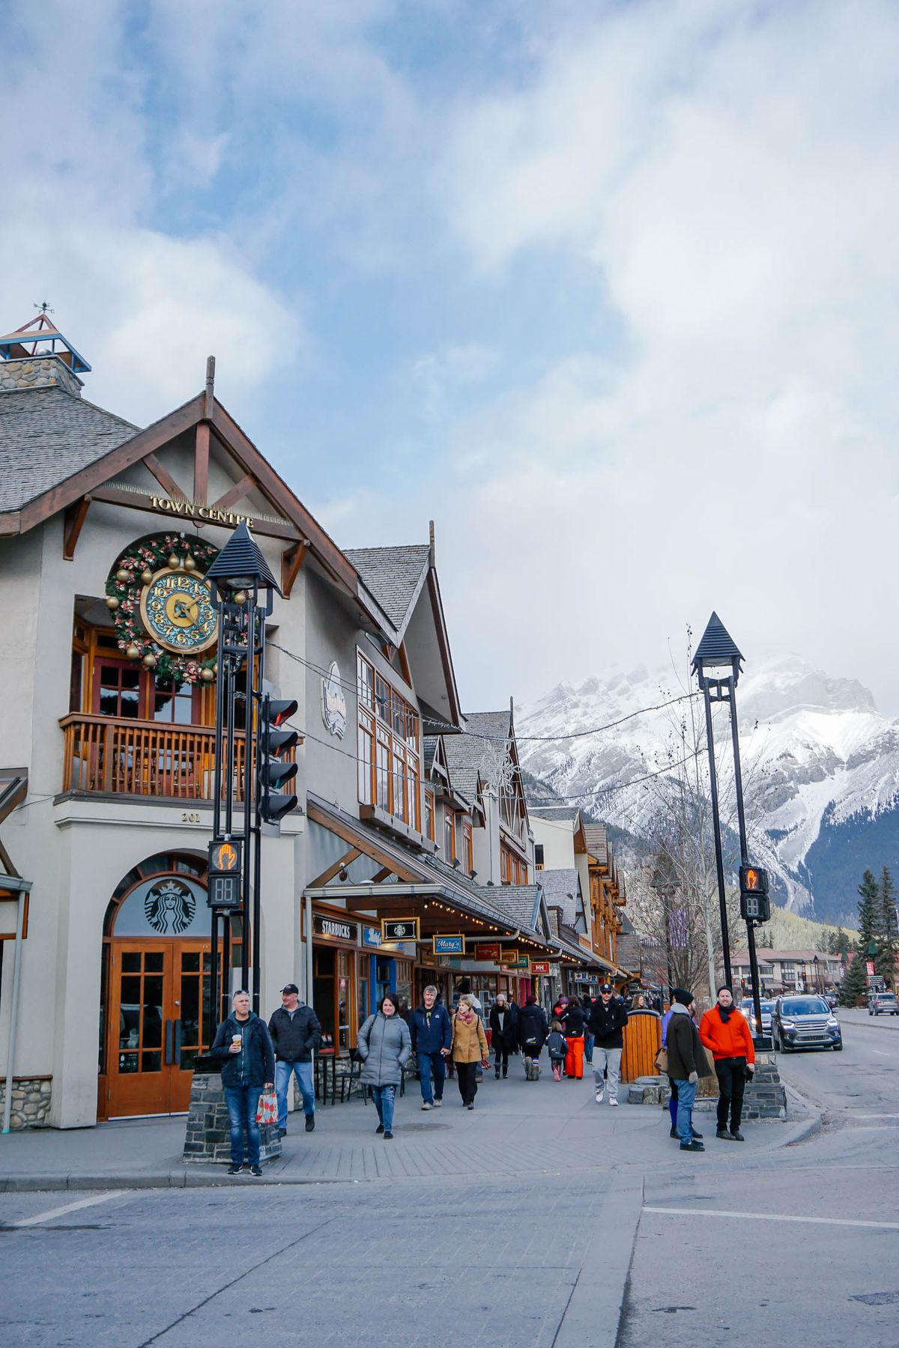
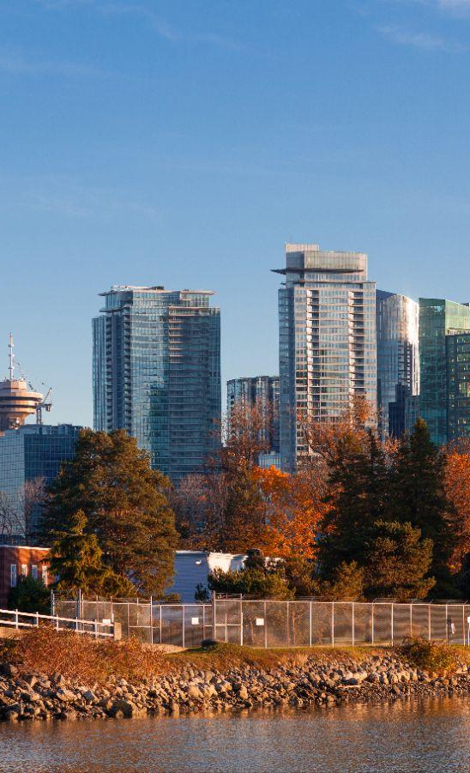
AUDIENCES
Large Tourism Businesses
Why they matter
ROLE IN TOURISM’S SUCCESS | Large tourism enterprises anchor Canada’s visitor economy, generating billions in GDP, investing heavily in infrastructure, and setting ESG and technology standards.
STRATEGIC RELEVANCE | Their global brands drive international demand, offer stable careers, and shape industry practices through investment, advocacy, and innovation..
KEY OUTCOMES | By setting benchmarks for workforce, sustainability, and connectivity, they create spillover benefits for more than 268,000 SMEs nationwide.
INFLUENCE ON PERCEPTION | Their visibility and policy influence strengthen Canada’s brand abroad, while unlocking visas, connectivity, and reforms that enhance competitiveness.

Slide 23
AUDIENCES
Large Tourism Businesses
01
Key Motivations
Predictable returns, scalable ventures, and risk mitigation
Market intelligence, sector unity, and influence
Tools for member support and innovation leadership
02
Call to Action
Champion the narrative to government and media
Coordinate consistent ecosystem messaging
03
Main Channels
Investment briefs and industry summits
Real estate expos and private investor roundtables
Sector conferences and national tourism summits
Member portals and trade publications
04
KPIs
Increased private capital investment
Positive investor sentiment
Narrative uptake by member organizations
Advocacy material inclusion
Cross-sector partnership development

Slide 24

AUDIENCES
Private Investors
Why they matter
ROLE IN TOURISM’S SUCCESS | Their capital fuels the development of tourism infrastructure, from resorts and attractions to transportation and experience-based ventures.
STRATEGIC RELEVANCE | Their involvement is crucial in achieving national and regional tourism goals, especially in underdeveloped or emerging tourism zones.
KEY OUTCOMES | Capital can scale tourism businesses and Indigenous-led ventures.
INFLUENCE ON PERCEPTION | High-profile investments often shape public discourse and government attention, including them ensures the narrative speaks the language of opportunity, risk, and return.

Slide 25
AUDIENCES
Private Investors
01
Key Motivations
Predictable returns and scalable ventures
Risk mitigation and market intelligence
02
Call to Action
Explore investment opportunities in tourism zones
Engage with DMOs, governments , and Indigenous Indigenous governments and communities on pipeline projects
03
Main Channels
Investment briefs and pitch decks
Industry summits and real estate expos
Private investor roundtables
04
KPIs
Increased private capital invested in tourism assets
Positive investor sentiment about Canada’s tourism sector

Slide 26

PART C
Key
Messages

Slide 27

MESSAGES
Canadians ≤40
01
Own your adventure. Co-author our story
Travel Canada with boundless passion and curiosity. Every journey you embark upon, every connection you make, helps write the next exciting, inclusive chapter for our country, making it richer, more deeply understood, and undeniably yours to shape and share. More than 9 in 10 Canadians are ready to welcome more visitors; lead by showing how it’s done.
02
Connect and empower with your unique voice
Use your digital fluency to share your real Canadian adventures, uncover hidden gems, and learn on the land with Indigenous hosts. Your authentic stories and perspectives do more than gather likes; they inspire genuine connection, redefine our national narrative for a new era, and encourage a tourism that truly reflects the diverse values of your generation.

Slide 28

MESSAGES
Canadians 40+
01
Connect, contribute and celebrate home
Rediscover the unparalleled beauty and rich diversity within Canada’s borders. Your travels are a direct lifeline for local economies, creating stable jobs for your neighbours and fostering the strong community and quality of life that we all cherish and strive to protect.
02
A way to guard our
nation’s history
Embrace your pivotal role in safeguarding and celebrating Canada’s diverse cultural tapestry and breathtaking natural wonders. Your exploration of local museums, heritage sites, and parks helps keep our collective history alive and ensures our pristine landscapes thrive for all time. Seek out Indigenous-owned experiences, your choices advance reconciliation.

Slide 29
MESSAGES
Federal Government
01
A high-value export driving Canada's trade balance
Recognize that every international visitor dollar is new wealth injected into our economy, significantly bolstering Canada's service exports, and contributing positively to our national trade balance and fiscal strength. Travel is an essential service for Canadians.
02
Unite regions and
strengthen Confederation
Tourism is a powerful, organic force that connects our diverse regions, celebrates our rich multicultural identity and profoundly builds national pride and cohesion. Your visible leadership and vocal support can amplify this uniquely unifying economic and social driver. Tourism operationalizes reconciliation, and investing with Indigenous initiatives scales impact.

Slide 30
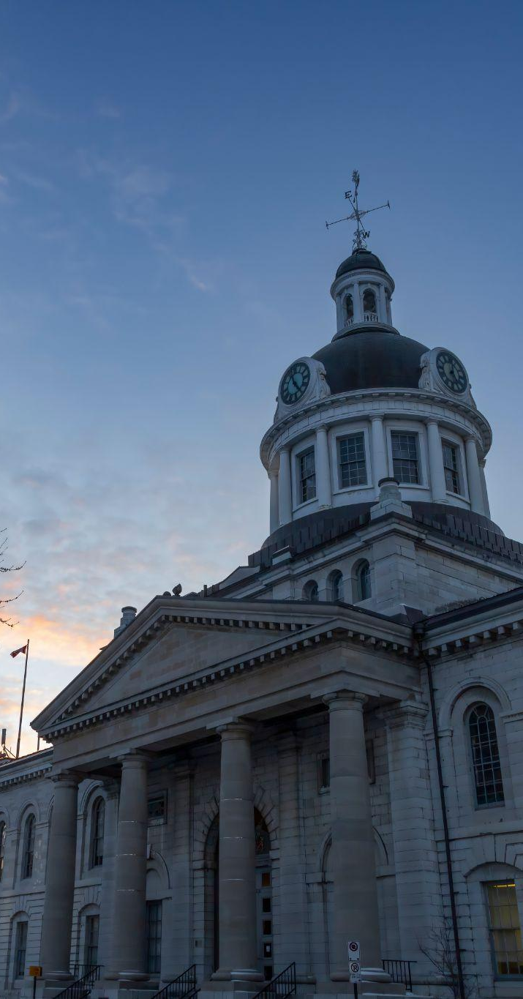
MESSAGES
Local Government
01
Invest in your community’s quality of life
Recognize that tourism revenues, with 20% of local governments prioritizing these tax benefits, directly support and enhance the critical services and infrastructure, from parks and recreation to public safety, that make your community a desirable place to live, work, and invest. Champion projects that amplify this positive cycle.
02
Energize your local
economy, ignite growth
Formally embed tourism as a cornerstone of your local and regional strategic plans. It’s a powerful and sustainable engine for diverse job creation, small business growth and lasting prosperity that resonates directly within your communities, where tourism contributes to keeping essential local services alive.

Slide 31

MESSAGES
Tourism Associations
01
Deep collaboration ignites unprecedented growth
Actively foster robust partnerships and strategic alliances across the entire tourism ecosystem, from grassroots operators to national corporations. By working as a truly integrated and supportive force, we unlock unprecedented opportunities for innovation and elevate Canada’s global tourism brand to new heights.
02
Drive evidence-based advocacy, deliver tangible results
Armed with compelling, irrefutable data and a shared, resonant story, we will effectively influence government decisions, attract significant new investment, and collaboratively overcome systemic challenges like workforce development, ensuring a thriving, sustainable future for all segments of our industry.
03
Empower our members, elevate our entire sector
Strategically equip your members with this powerful, data-rich national narrative. By speaking with one voice, we clearly demonstrate tourism's profound economic and social value, thereby securing the recognition, investment, and policy support our vital sector unequivocally deserves.

Slide 32

MESSAGES
DMOs
01
Be the indispensable catalyst for local prosperity and pride
Recognize that your crucial role extends far beyond promotion; you are vital community builders and economic enablers. Drive sustainable growth, foster deep and lasting resident pride, celebrate Indigenous storytelling, and make your unique destination a beacon of Canadian hospitality and innovation.

Slide 33



MESSAGES
Tourism SMEs
01
Your local impact,
globally celebrated
Every single job you create, every guest you delight with exceptional service, every local supplier you steadfastly support, it all contributes significantly to building a stronger, more vibrant Canada. Be immensely proud of the profound and positive difference you make every
single day!
02
You are the heartbeat of Canadian tourism
Your boundless creativity, entrepreneurial spirit, and daily dedication are the essence of every unforgettable visitor experience in Canada. This shared national story helps your unique business, one of over 268,000 in the sector, shine even brighter and connect more deeply with travellers seeking authenticity.

Slide 34
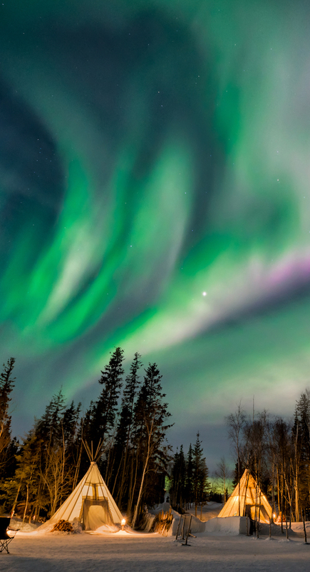
MESSAGES
Large Tourism Businesses
01
United for impact, leading Canada’s visitor economy
Every dollar you invest, every global standard you set, and every international traveller you attract strengthens Canada’s position on the world stage. From airlines and hotels to attractions and infrastructure, your scale fuels billions in GDP, drives stable careers, and unlocks opportunities that ripple across 268,000 SMEs nationwide.
02
Champions of growth and global confidence
Your trusted brands and bold investments, like the $2B hotel surge of 2024, are more than business wins; they are catalysts for national pride, cohesion, and competitiveness. By setting benchmarks in sustainability, technology, and service, you don’t just welcome the world to Canada, you inspire confidence in our tourism future. Your scale can mainstream Indigenous procurement, leadership and measurement.

Slide 35
MESSAGES
Investors
01
Unlock unrivaled opportunity in a proven market
Canada’s dynamic and consistently growing tourism sector, which saw tourism GDP rise 3.8% in 2024 outpacing the general economy, presents a compelling and stable environment for high-return investments in a truly world-class, globally recognized destination. This is your moment to capitalize on proven strength.
02
Invest with confidence in a resilient growth sector
Partner with a resilient industry that’s not just recovering but is set for sustained expansion, backed by strong market fundamentals, a supportive and stable business ecosystem, and continuously increasing international visitor arrivals. Canada is demonstrably ready for your strategic capital.

Slide 36


PART D
Tourism
Narrative
Resources

Slide 37

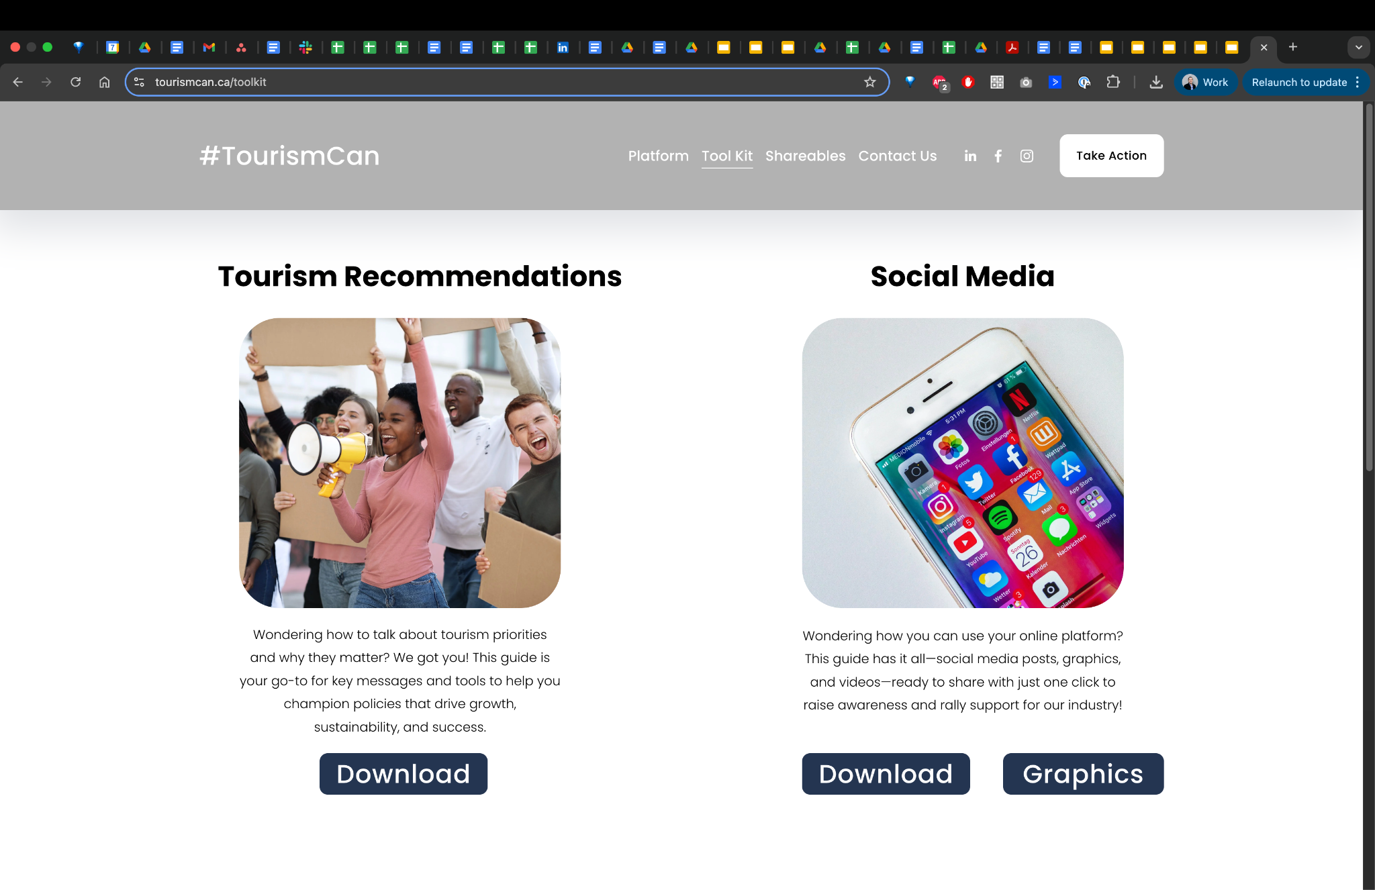
RESOURCES
TourismCan

Slide 38
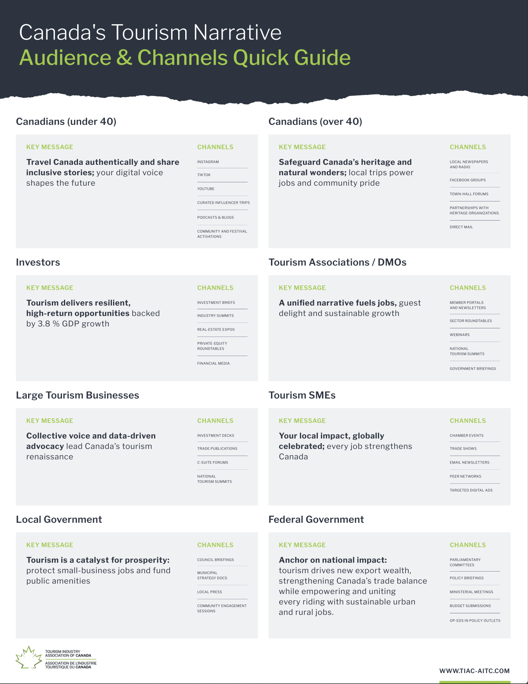


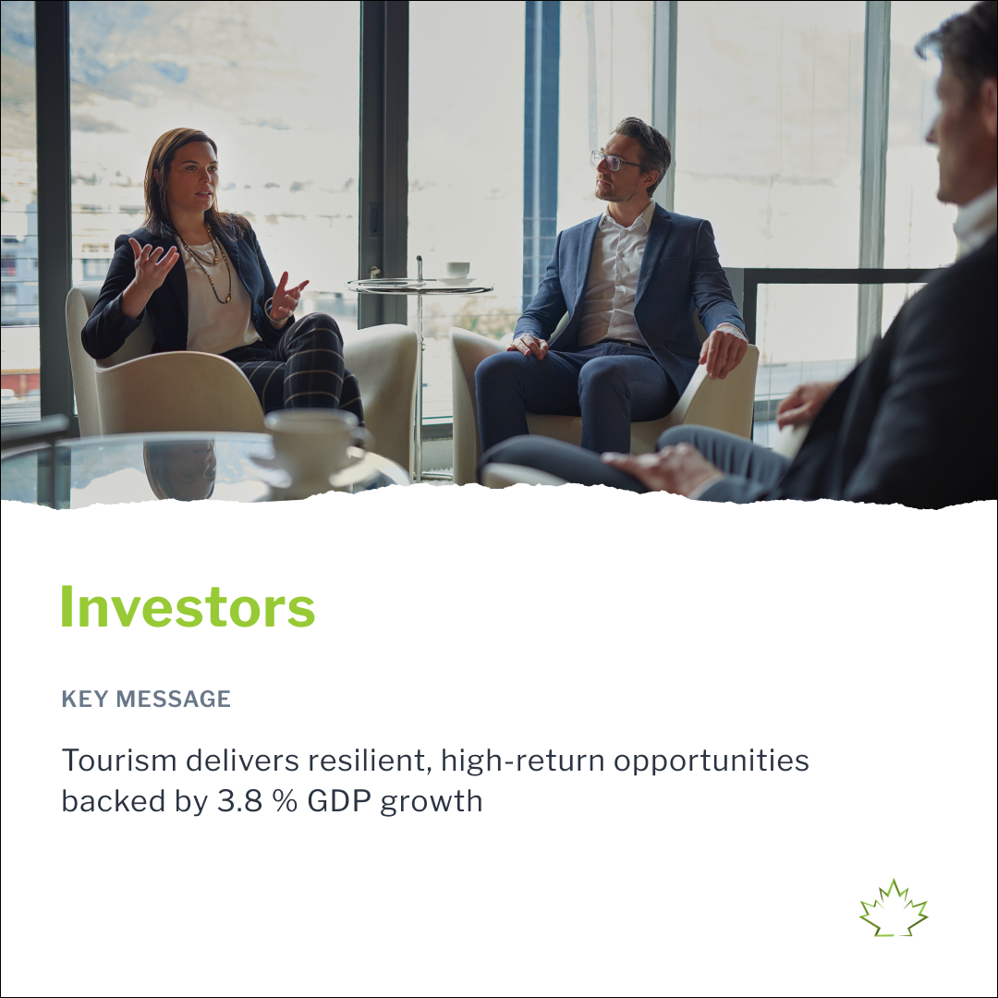
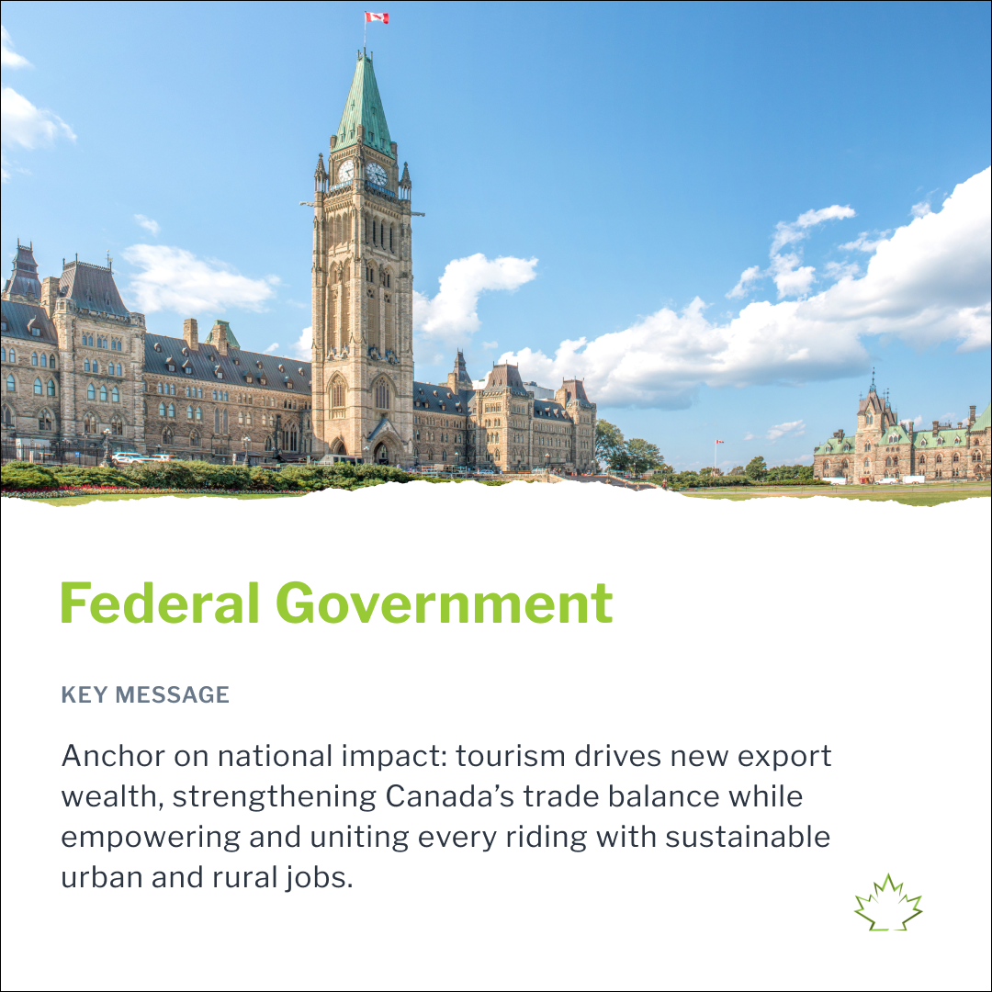
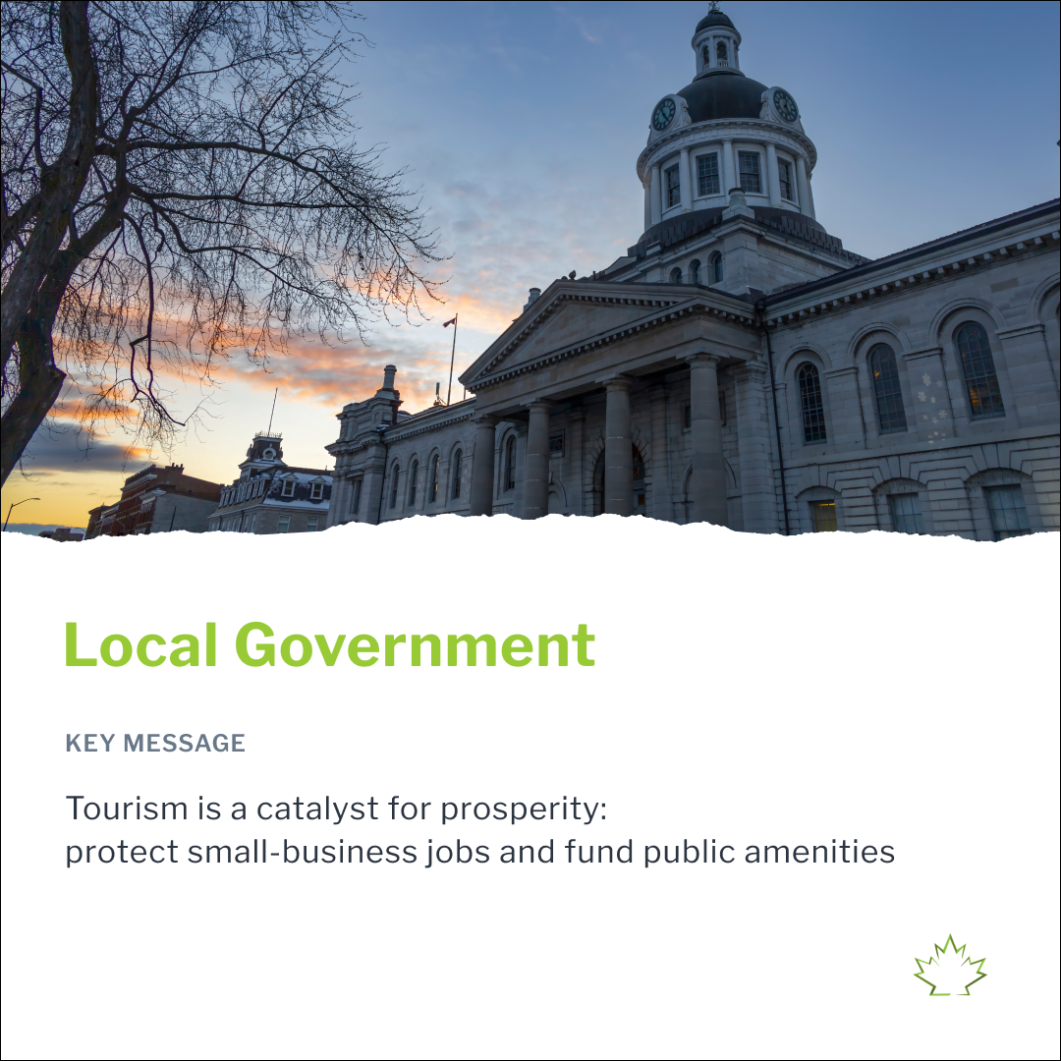

RESOURCES
Key Resources
Tourism Narrative Matrix
Tourism Narrative Social Assets
Tourism Narrative Toolkit
Audiences / Key Messages
Tourism Narrative FAQ
Social Assets
Sizzle Reel

Slide 39


Slide 40
Appendix

Slide 41

APPENDIX
Stakeholder
Engagement

Slide 42
APPENDIX
What We Heard?
To better understand current perceptions of tourism and explore narrative opportunities, 20+ stakeholders were interviewed in the following groups: DMO, Education, Government, Hospitality, National Association, Provincial Association, PTO, Tourism Business, Business Development, MICE, Transportation, Finance, Media, Policy, Workforce, Research.

Slide 43
NARRATIVE
Tourism Narrative Challenges (1/2)
01
Narrative Fatigue and Ineffectiveness
The existing language around tourism ("Visitor Economy," "Hosting Economy") no longer resonates with stakeholders or the public.
The public associates "tourism" with leisure clichés (“umbrella drinks and beaches”), diminishing its perceived seriousness as a sector.
Overused stats (e.g., job numbers) no longer generate interest or relevance, GDP figures feel impersonal and abstract.
02
Perception Gap with Policymakers
Policymakers often believe they understand tourism because they travel, but lack appreciation for its complexity and impact.
Many federal officials still don’t see tourism as an economic driver or “vote-getter.”
Lobbying is sporadic and disconnected from ministerial priorities or riding-level storytelling​.
03
Lack of Investment and Competitiveness
Tourism is not treated as an economic development priority in the same way as natural resources or tech.
Tourism is not seen as a critical sector like energy, finance, or professional services, despite its widespread economic footprint.

Slide 44
NARRATIVE
Tourism Narrative Challenges (2/2)
04
Lack of Unified Definition
of Tourism
A fractured industry (250,000+ businesses, many SMEs) weakens advocacy and makes messaging less cohesive.
Tourism is poorly defined and inconsistently understood by both government and industry.
Treasury boards and economists do not consider it a coherent sector, it's viewed as fragmented, made up of low-value, entry-level jobs.
05
Missed Messaging Opportunities
Tourism’s broader benefits (e.g., first jobs for youth, community infrastructure, on-ramp for newcomers) are not clearly communicated.
Sector contributions to social services and quality of life (e.g., funding coffee shops, grocery stores in small towns) are undervalued.
Tourism’s strategic role in trade, economic diversification, national pride and as a vehicle for reconciliation and Indigenous ownership is overlooked.

Slide 45
NARRATIVE
Tourism Narrative Opportunities (1/3)
01
Reframe Tourism as
Essential Infrastructure
Position tourism as the “ultimate renewable resource”, present in every community and tied to national prosperity.
Compare it with natural resources industries to elevate its stature among policymakers and the public.
Frame tourism infrastructure as immovable and resilient, unlike extractive industries, tourism investments stay local.
Reposition tourism as a tool for economic diversification.
02
Perception Gap with Policymakers
Shift from abstract stats to personal relevance: from “2 million jobs.” to “2 million households earn income from tourism”, or “Tourism supports nurses, entrepreneurs, etc.”
Create riding-level storytelling: Show each MP how tourism impacts their constituency (e.g., heat maps, worker testimonials).
03
Emphasize Global Competitiveness
Make the case that tourism growth = economic growth; highlight how much other countries are investing in tourism.
Use global comparisons to motivate policymakers.

Slide 46
NARRATIVE
Tourism Narrative Opportunities (2/3)
04
Reposition Language:
Travel as Trade
Experiment with shifting language from “tourism” to “travel economy” or “trade through travel.”
Reinforce the idea that tourism is not frivolous, it’s a services export sector, a jobs engine, and a connector to global markets.
Associate travel to leisure and business meetings and events.
05
Elevate Tourism
as Policy Solution
Present tourism as a vehicle for reconciliation, inclusion, and youth employment.
Frame it as a testbed for broader policies, workforce development, rural revitalization, climate adaptation.
Use tourism’s presence in every riding as leverage for national policy support and funding alignment.
06
Frame Tourism as a
Career Starter and Community Anchor
Highlight how tourism provides an on-ramp to work for youth, newcomers, and marginalized groups.
Reposition sector from “transient employment” to career pathways that are inclusive and rooted in place​

Slide 47
NARRATIVE
Tourism Narrative Opportunities (3/3)
07
Indigenous Tourism as a National Strength
Reposition Indigenous tourism as a “world-leading export,” not just a cultural offering.
Align messaging around reconciliation with economic opportunity and ownership, this resonates with both public and government audiences​.
08
Leverage Local-Level Narratives
Communicating tourism’s value at the community or municipal level (e.g., how it supports grocery stores, cultural festivals, job stability) is more powerful than top-down narratives.
Use regional press, localized data, and case studies to make tourism feel real and relevant​.

Slide 48


APPENDIX
Canadians
Current
Perception of
Tourism

Slide 49
PERCEPTION SURVEY
Key Findings
01 | More than 9-in-10 Canadians are open to having more tourists visit Canada (92%).
02 | 2-in-3 Canadians have a positive impression of the tourism sector (65%) in Canada, and its contribution to the economy (62%).
03 | Canadians are more likely to associate their perception of the tourism sector to the tourism experiences (30%) and economic impact on businesses (29%).
04 | Younger generations share a more negative perspective of the tourism sector, while older generations further recognize tourism’s impact on local communities.
05 | Positive impressions about the tourism sector are most often linked to supporting and generating revenue for the Canadian economy, positioning Canada as a nice place to visit, and offering things to do.

Slide 50
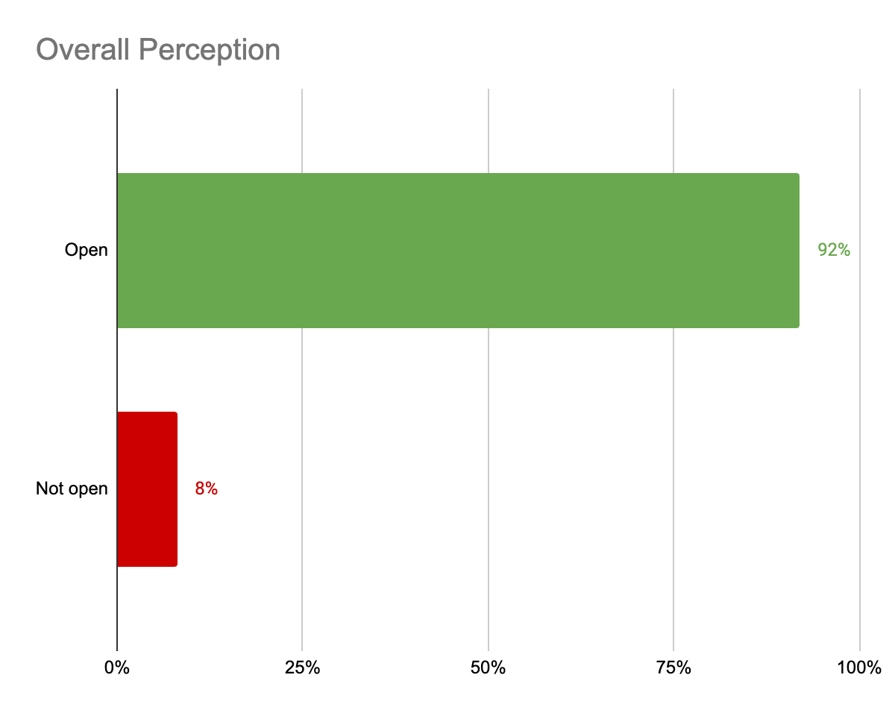
PERCEPTION SURVEY
The majority of Canadians are open to having more tourists
visit Canada.
Q: Are you open, somewhat open, somewhat not open or not open to having more tourists visit Canada? (n= 1,819) Source: Edelman, 2024

Slide 51
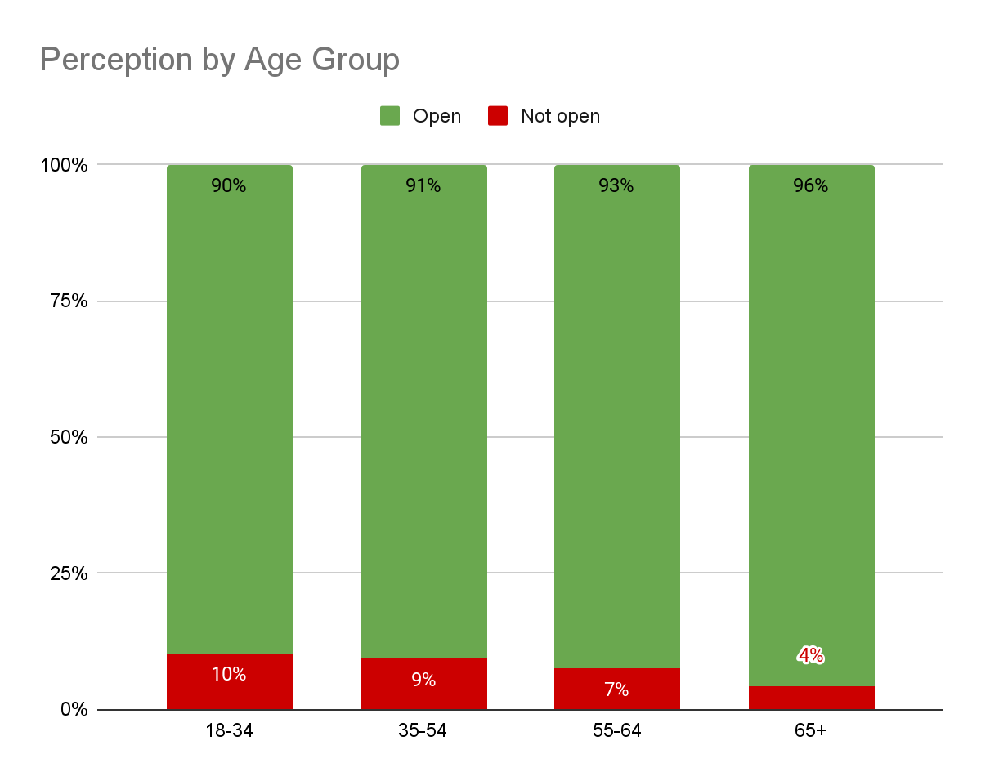
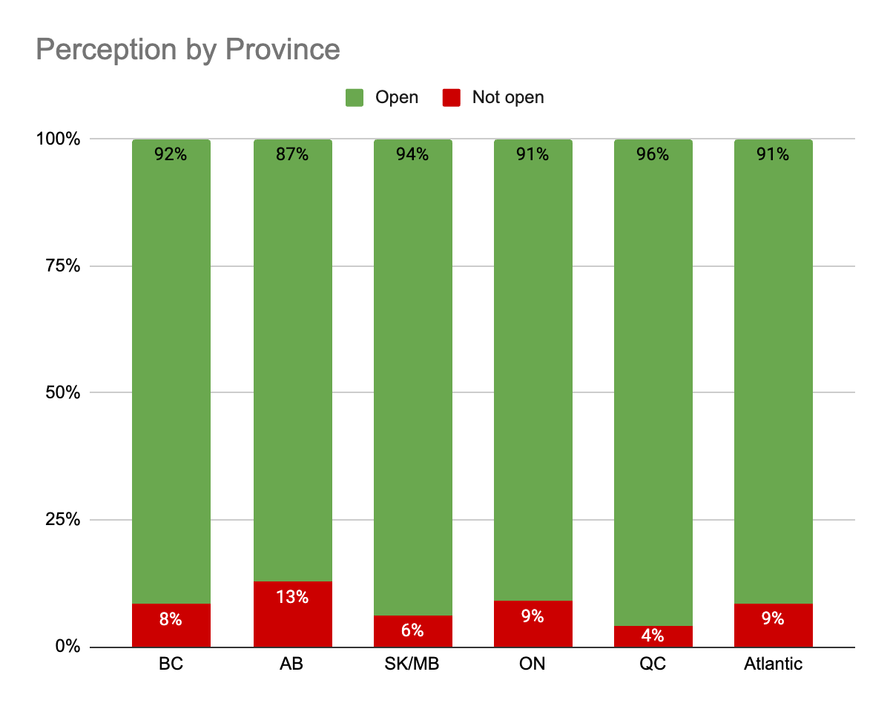
PERCEPTION SURVEY
While openness to tourism is high across Canada,
younger Canadians are less open to having more
tourists visit Canada.
Overall, Canadians across provinces are generally open to welcoming more tourists. However, openness to tourism is relatively lower in Alberta, Ontario, the Atlantic provinces, and British Columbia.
Q: Are you open, somewhat open, somewhat not open or not open to having more tourists visit Canada? (n= 1,819) Source: Edelman, 2024

Slide 52
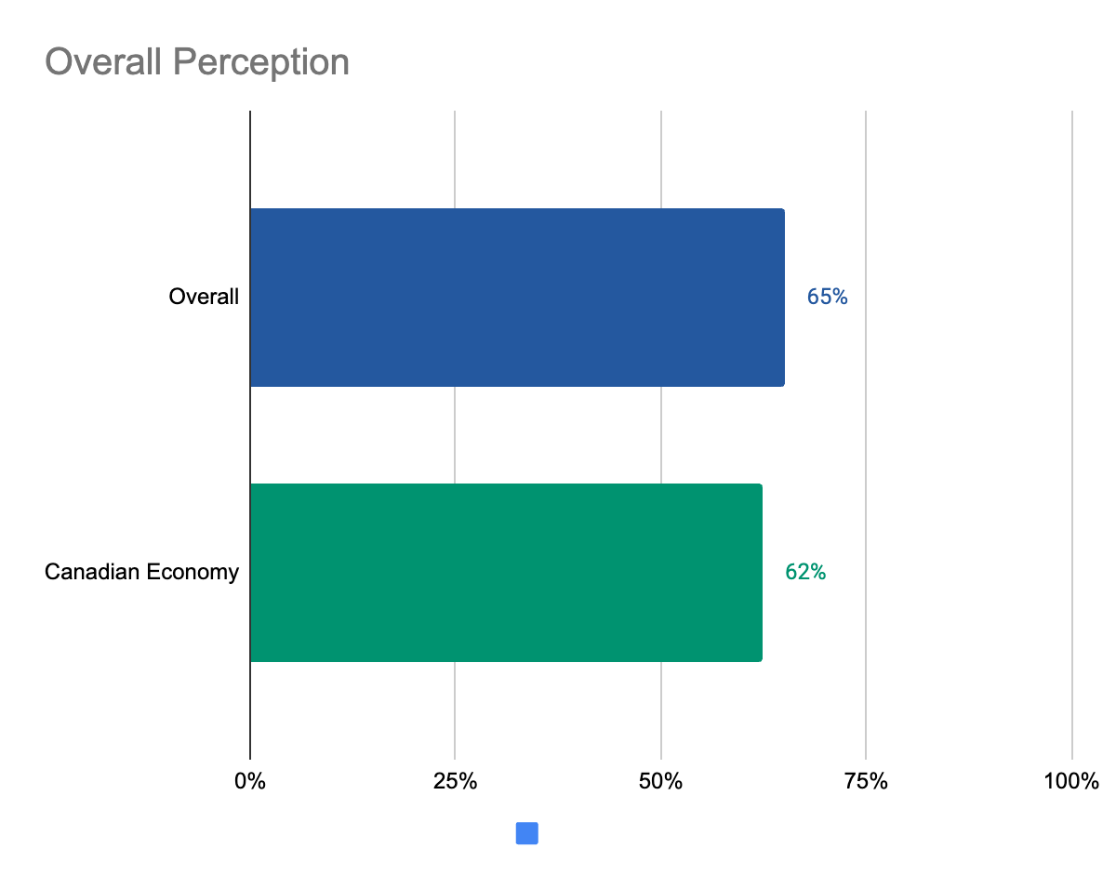
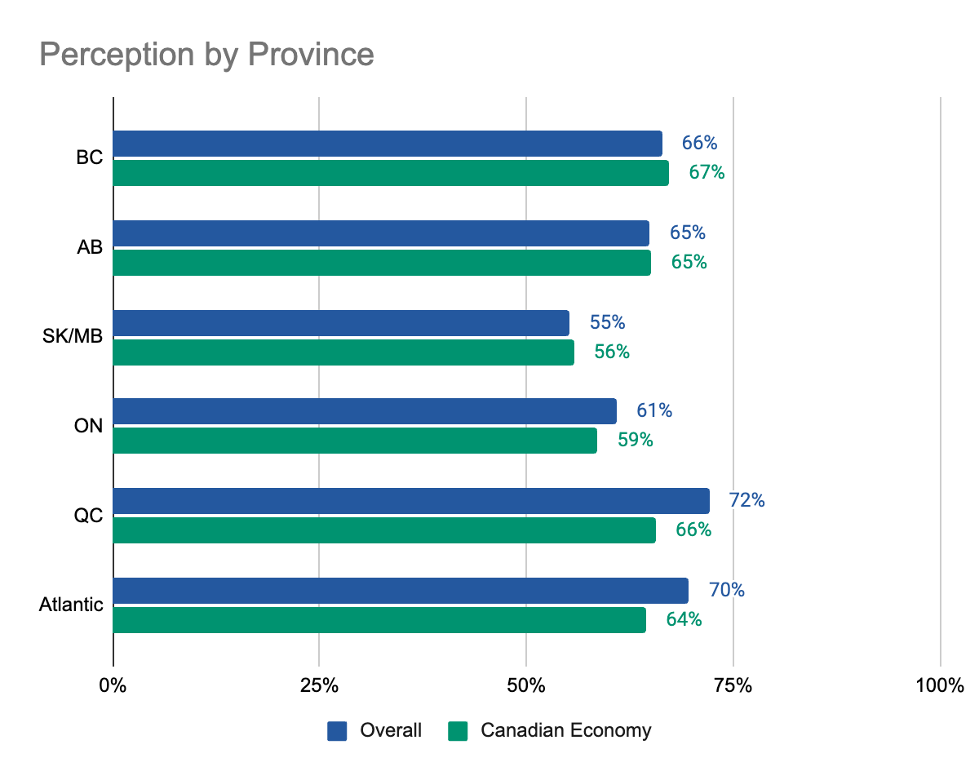
PERCEPTION SURVEY
The overall perception of the tourism sector and its impact on the Canadian economy are closely aligned. 62% of Canadians have a positive impression of the tourism sector's impact on the national economy, compared to 65% overall. Among Canadians aged 18-34 and 35-54, there is a five-point difference in perception.
Canadians in Quebec and Atlantic provinces share a higher level of support for tourism, Saskatchewan and Manitoba the lowest. While overall perception is positive in these provinces, the overall impression of the impact of the tourism sector on the Canadian economy is similar, other than in Ontario, Saskatchewan, and Manitoba.
Q: On a scale of 0 to 10 where 0 is a completely negative impression and 10 is a completely positive impression, how would you rate your overall impression of the tourism sector in Canada? (n= 1,819) Source: Edelman, 2024
Q: On a scale of 0 to 10 where 0 is a completely negative impression and 10 is a completely positive impression, how would you
rate your overall impression of the impact of the tourism sector on the Canadian economy? (n= 1,819) Source: Edelman, 2024

Slide 53
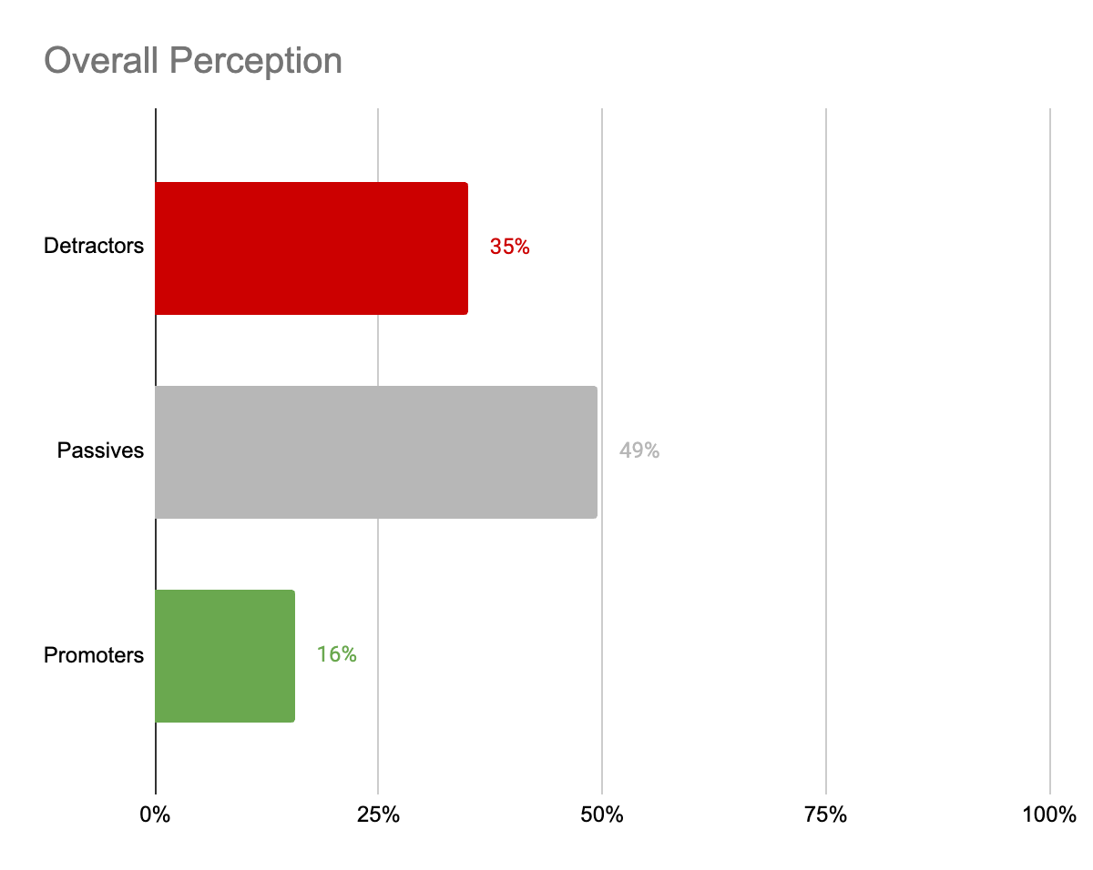
PERCEPTION SURVEY
65% of Canadians have a positive impression of the tourism sector in Canada.
Q: On a scale of 0 to 10 where 0 is a completely negative impression and 10 is a completely positive impression, how would you rate your overall impression of the tourism sector in Canada? (n= 1,819) Source: Edelman, 2024

Slide 54
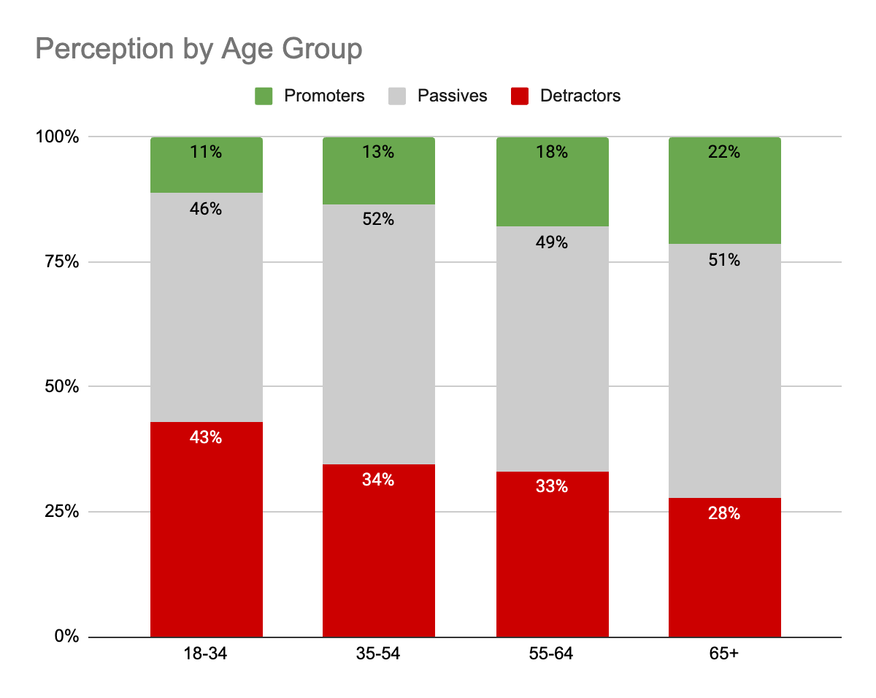
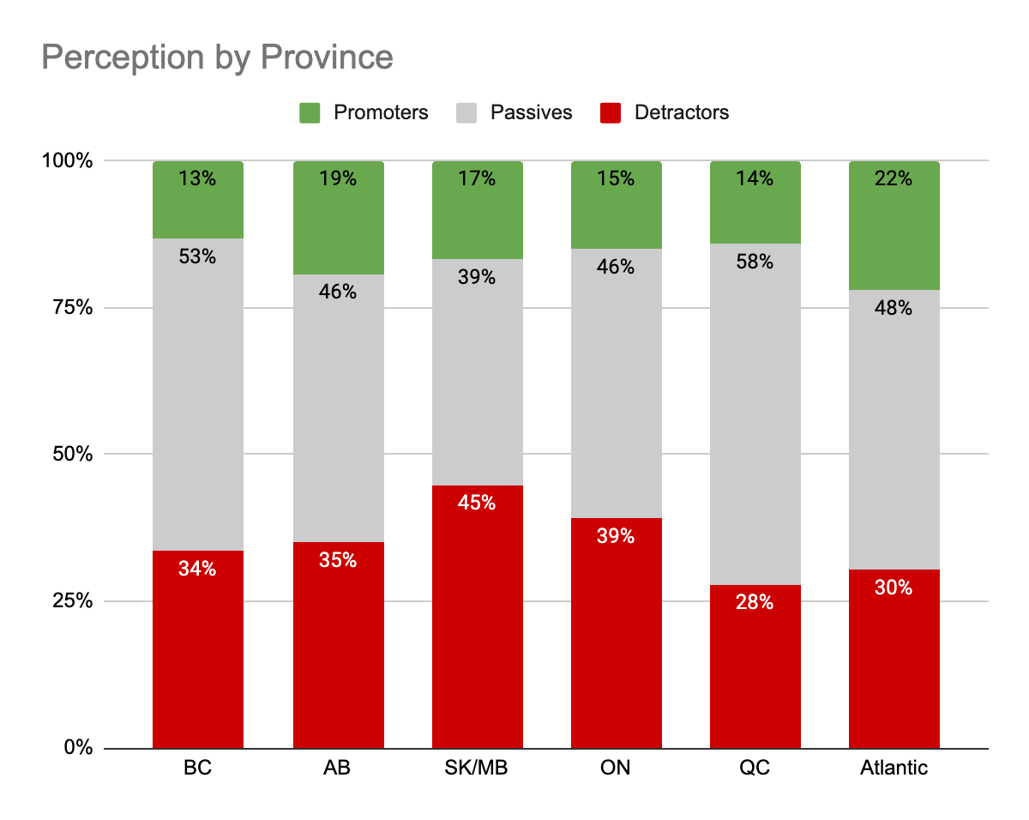
PERCEPTION SURVEY
Younger Canadians show less support for tourism, while older Canadians have a more positive attitude.
Canadians in Atlantic provinces share a higher level of support for tourism, compared to the Prairies and Ontario with the lowest rates.
Q: On a scale of 0 to 10 where 0 is a completely negative impression and 10 is a completely positive impression, how would you rate your overall impression of the tourism sector in Canada? (n= 1,819) Source: Edelman, 2024

Slide 55
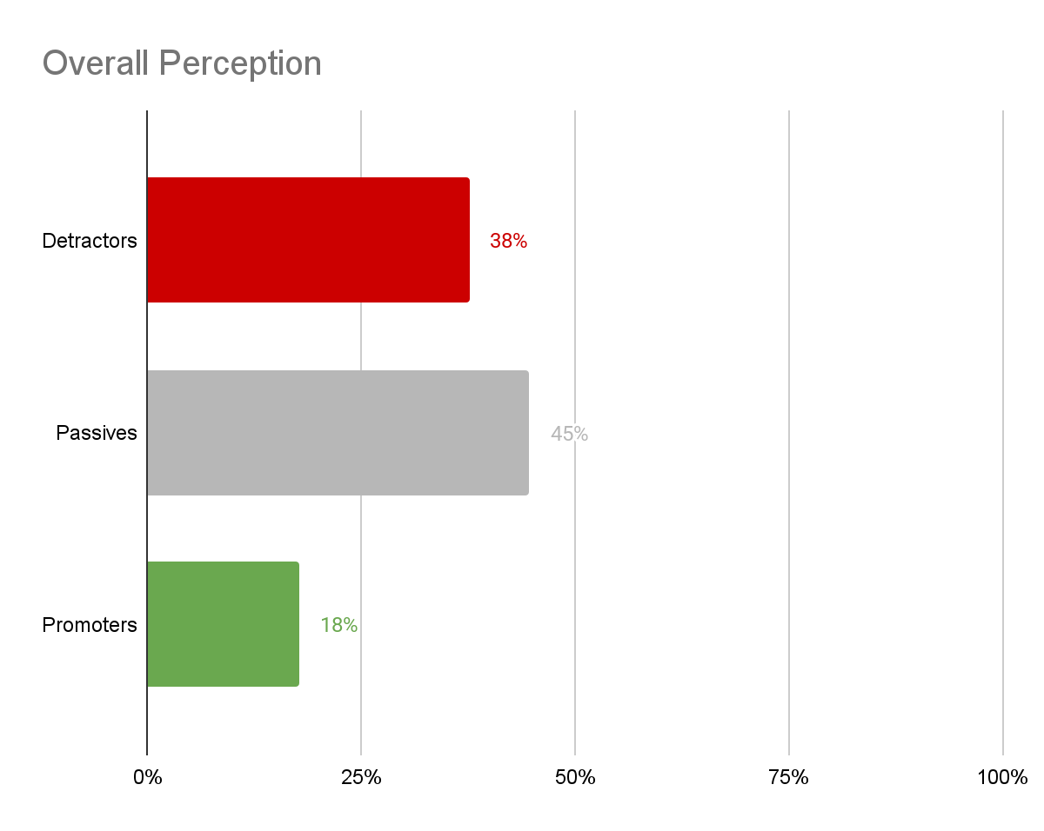
PERCEPTION SURVEY
62% of Canadians have a positive impression of the impact of the tourism sector on the Canadian economy, compared to 65% overall.
Q: On a scale of 0 to 10 where 0 is a completely negative impression and 10 is a completely positive impression, how would you rate your overall impression of the impact of the tourism sector on the Canadian economy? (n= 1,819) Source: Edelman, 2024

Slide 56
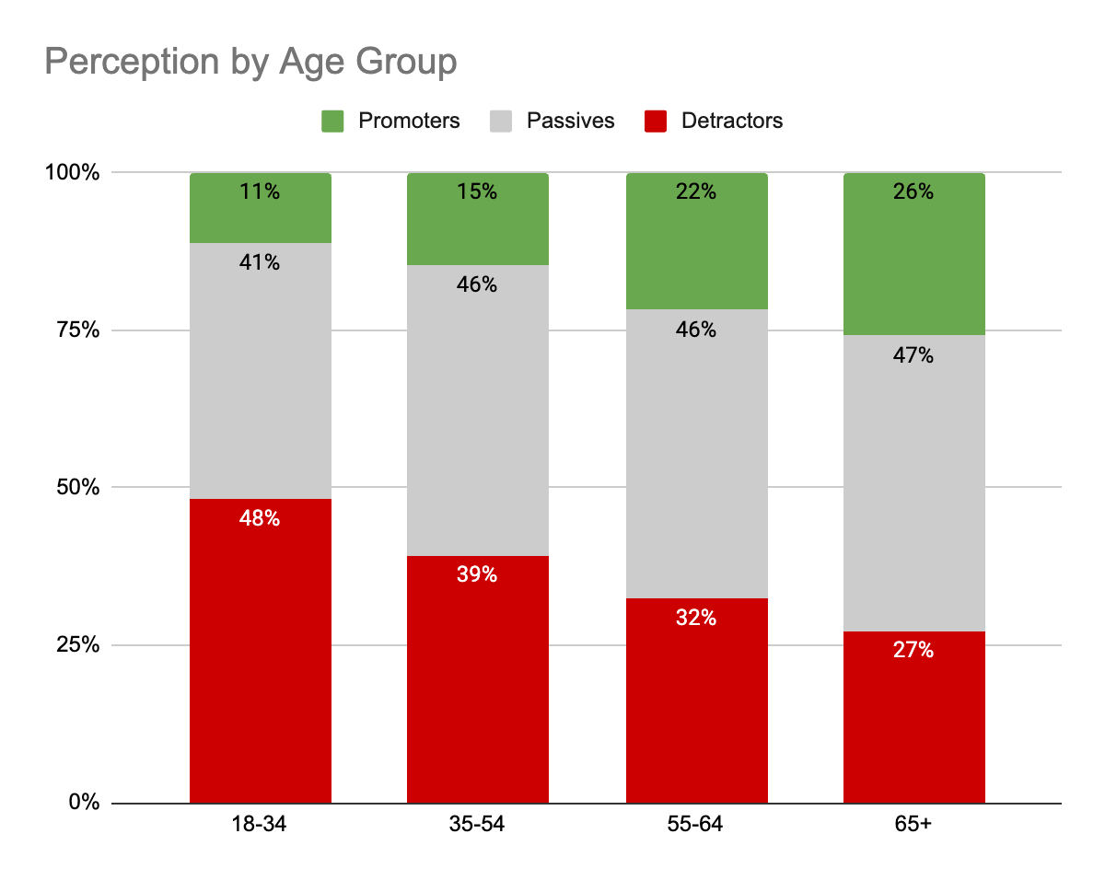
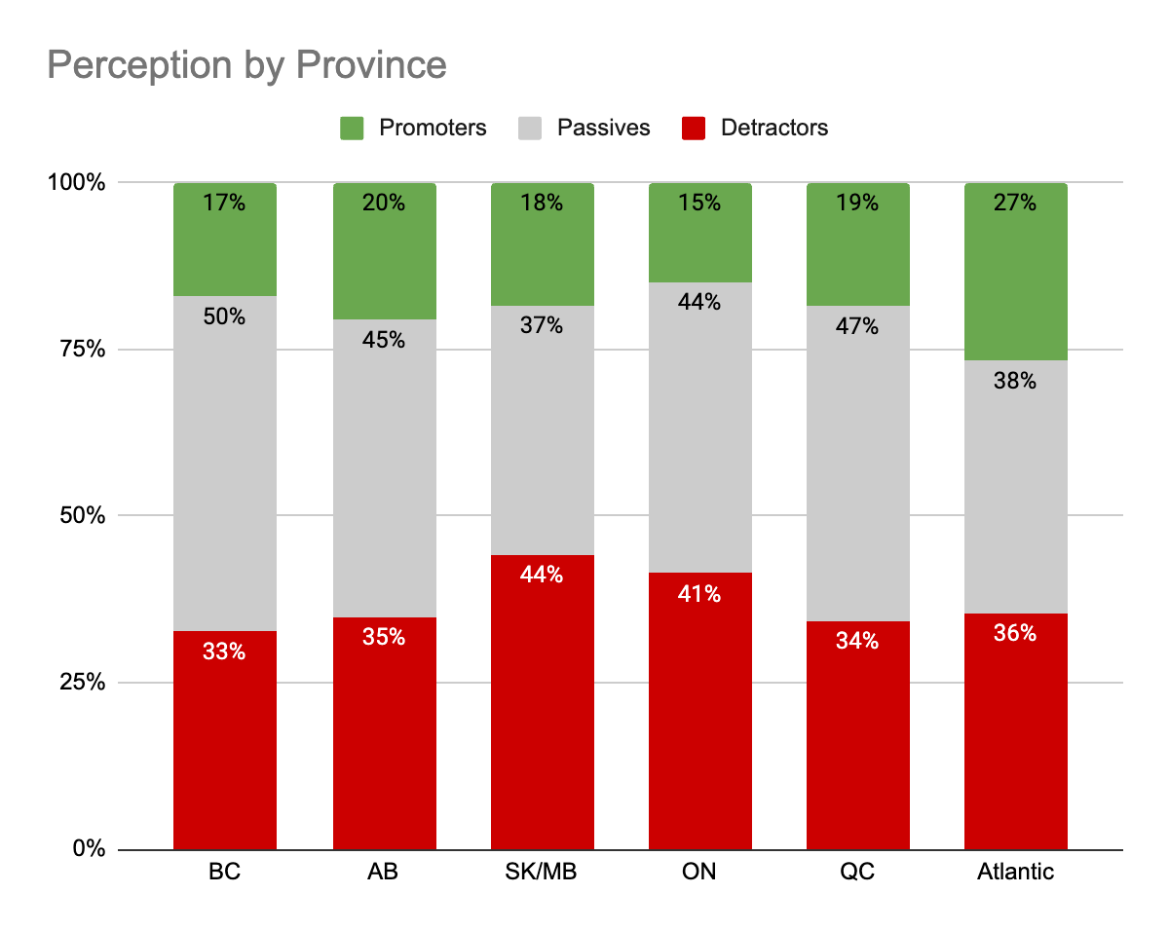
PERCEPTION SURVEY
Younger Canadians have a more negative impression of the impact of the tourism sector on the Canadian economy.
Tourism has a higher impact on the Canadian economy according to Canadians in Atlantic provinces compared to the Prairies and Ontario.
Q: On a scale of 0 to 10 where 0 is a completely negative impression and 10 is a completely positive impression, how would you rate your overall impression of the impact of the tourism sector on the Canadian economy? (n= 1,819) Source: Edelman, 2024

Slide 57
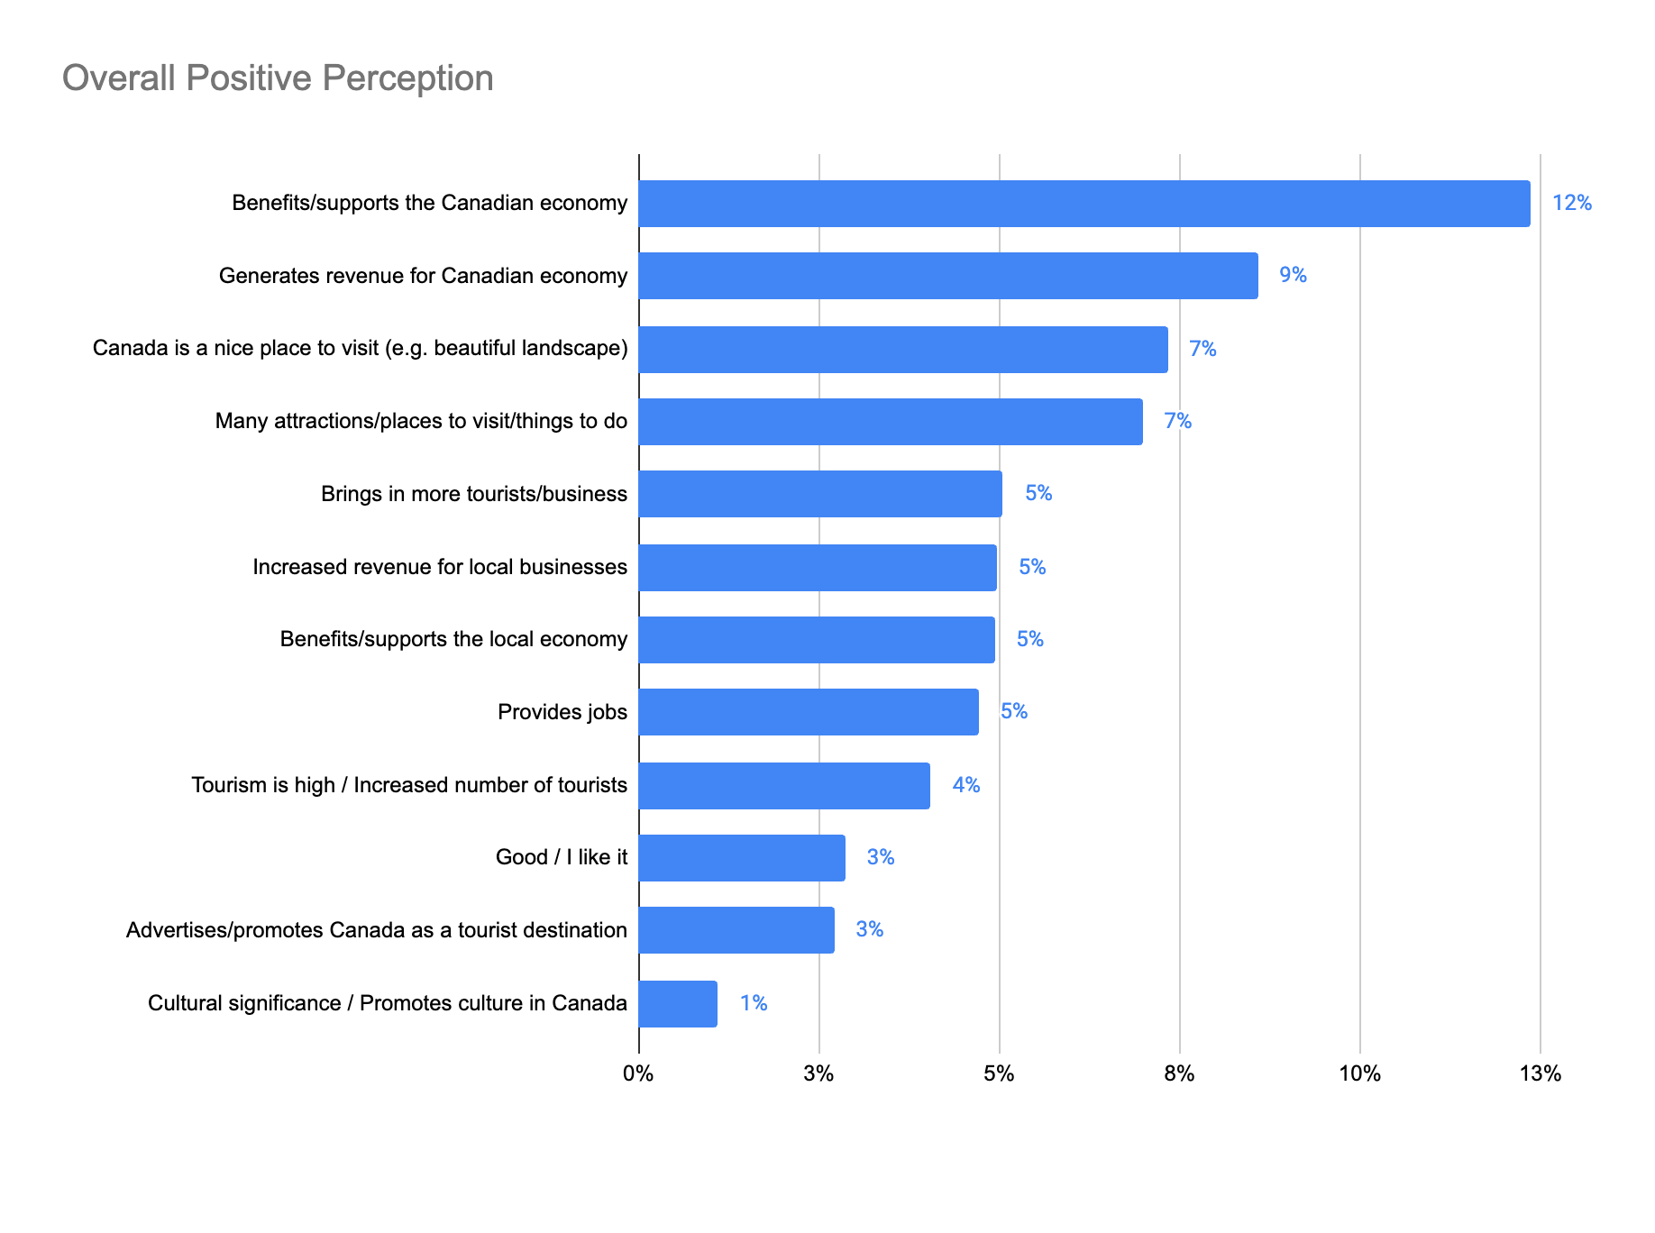
PERCEPTION SURVEY
Benefits/supports the Canadian economy, generates revenue for Canadian economy, and Canada is a nice place to visit are the most important regarding the impact of tourism.
Q: Why do you have that opinion about the impact of the tourism sector on the Canadian economy? (n= 1,819) Source: Edelman, 2024

Slide 58
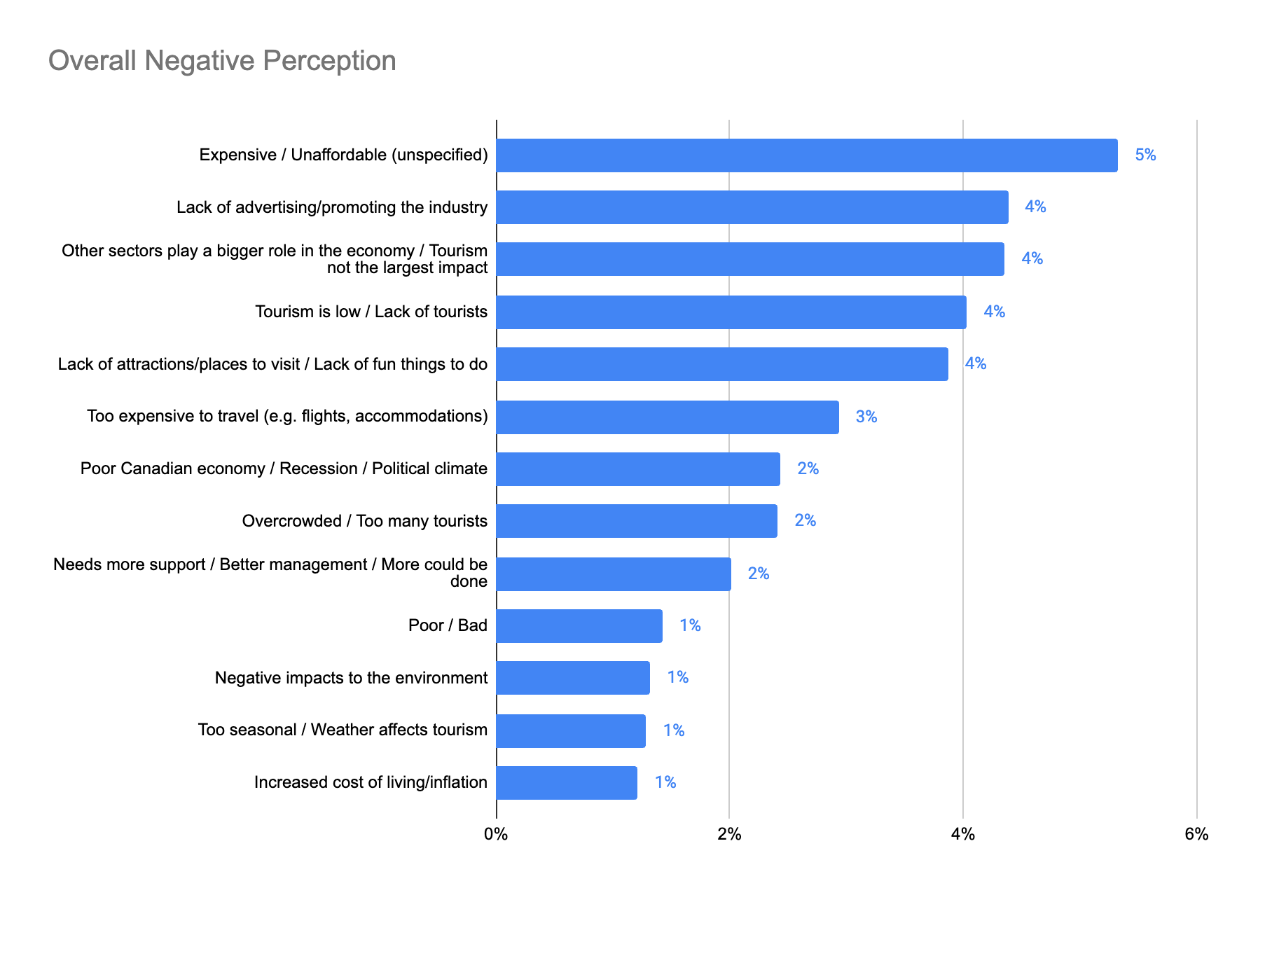
PERCEPTION SURVEY
Expensive unaffordable, lack of advertising promoting the industry, other sectors play a bigger role in the economy, and tourism is low contribute to the negative perception of tourism.
Q: Why do you have that opinion about the impact of the tourism sector on the Canadian economy? (n= 1,819) Source: Edelman, 2024

Slide 59
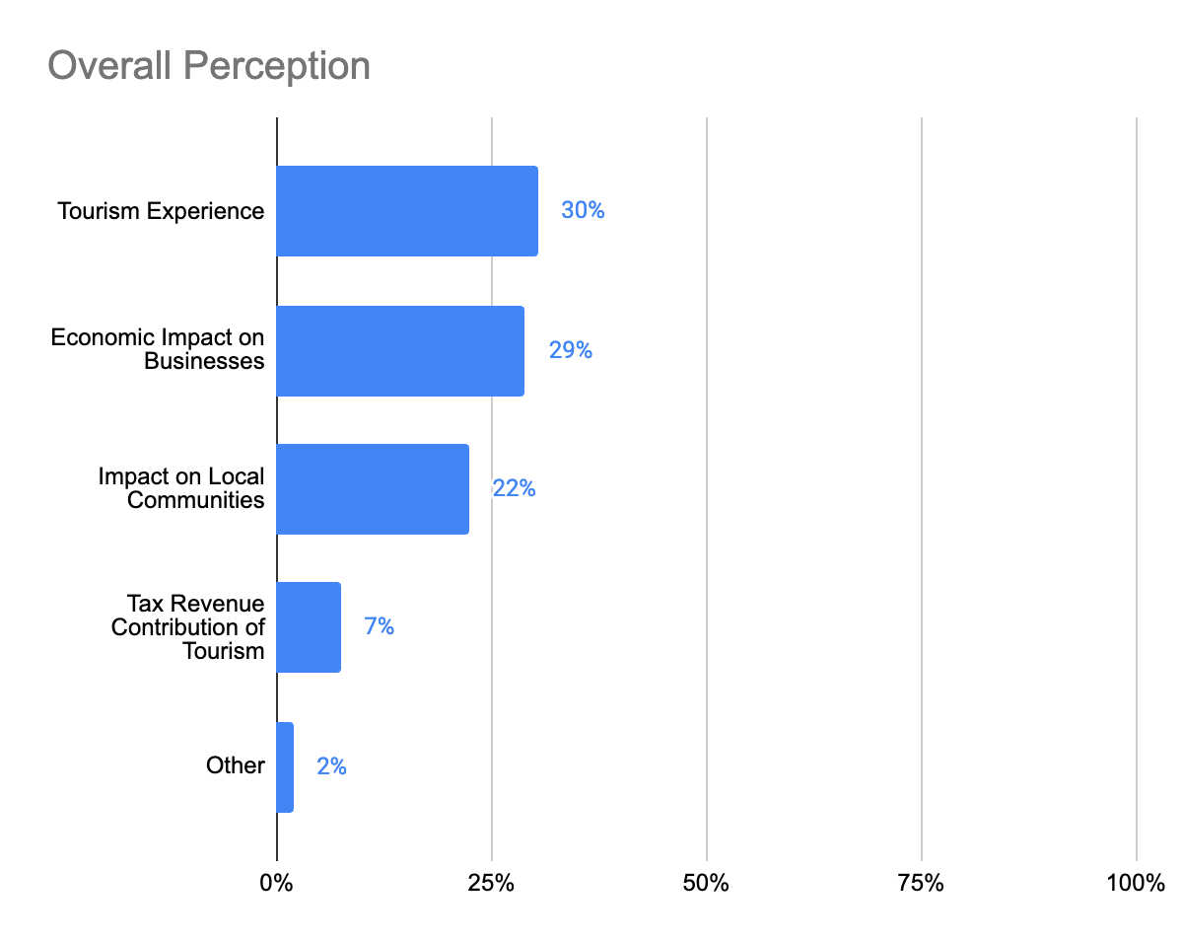
PERCEPTION SURVEY
Tourism experience and economic impact on businesses are the most important.
Q: When you think of the tourism sector in Canada, what first comes to mind? (n= 1,819) Source: Edelman, 2024

Slide 60
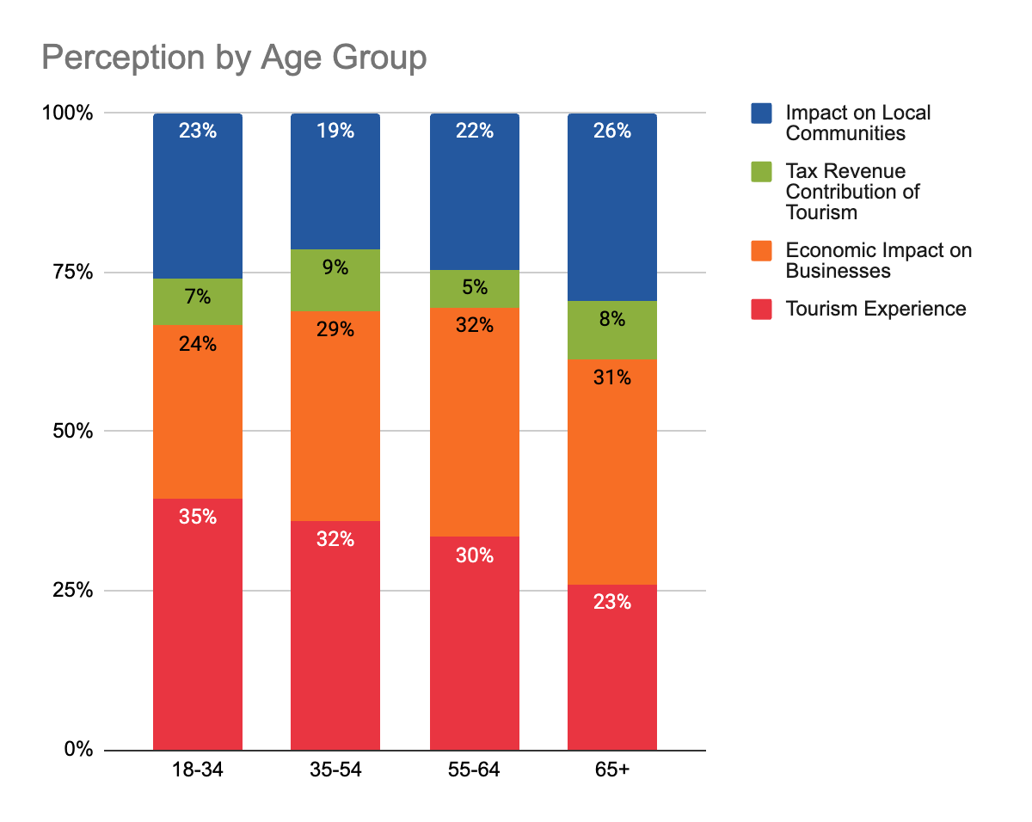
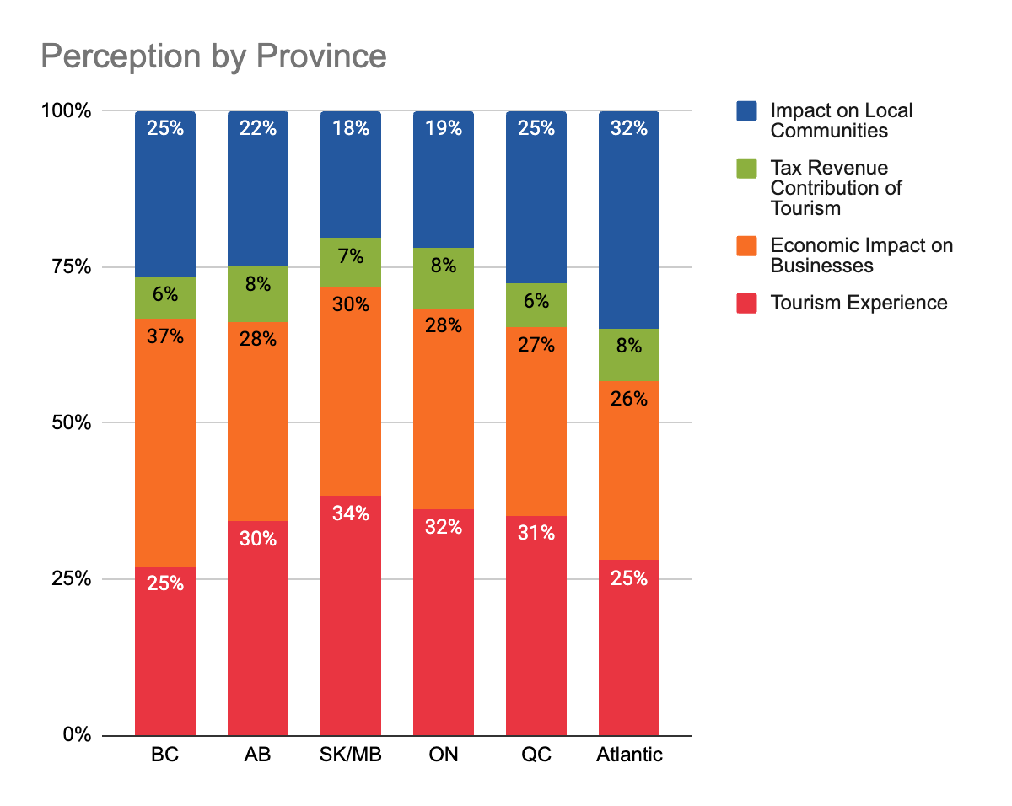
PERCEPTION SURVEY
Tourism experience is more important to younger Canadians, while impact on local communities and economic impact on businesses is more important to older generations.
Tourism’s economic impact on businesses is key to all provinces, followed by the experiences that tourism offers. The tax revenue contribution of tourism is not automatically linked to the sector. Canadians in Atlantic Canada are more likely to recognize the impact of tourism on local communities.
Q: When you think of the tourism sector in Canada, what first comes to mind? (n= 1,819) Source: Edelman, 2024

Slide 61
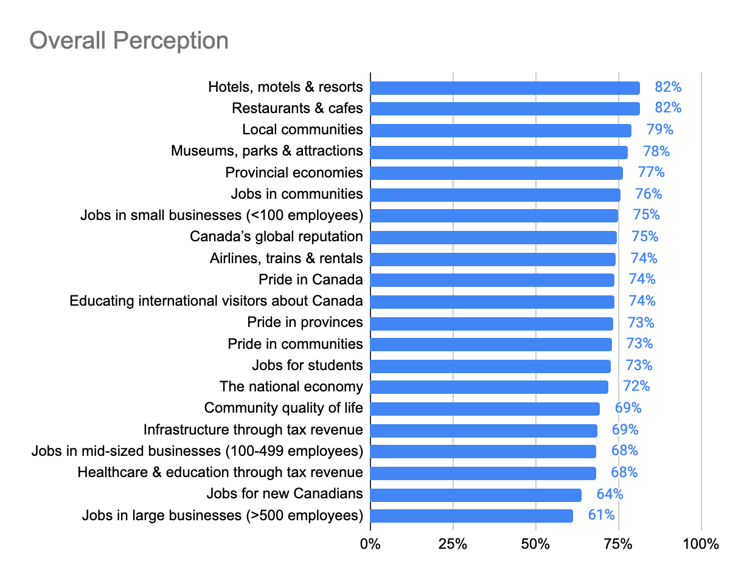
PERCEPTION SURVEY
The economic impact of the tourism sector on local hotels, motels and resorts, on local businesses like restaurants and cafes, and local communities are the most important.
Canadians do not associate the tourism sector with large business employers, job opportunities for new Canadians, event infrastructure investments, or quality of life improvements.
Q: Please rate the following statements where 0 is not at all important and 10 is very important. The economic impact of the tourism sector on … That a strong tourism sector creates … Q5r17: That the tourism sector provides opportunities for …(n= 1,819) Source: Edelman, 2024

Slide 62

APPENDIX
Key Messages
for Canadians

Slide 63
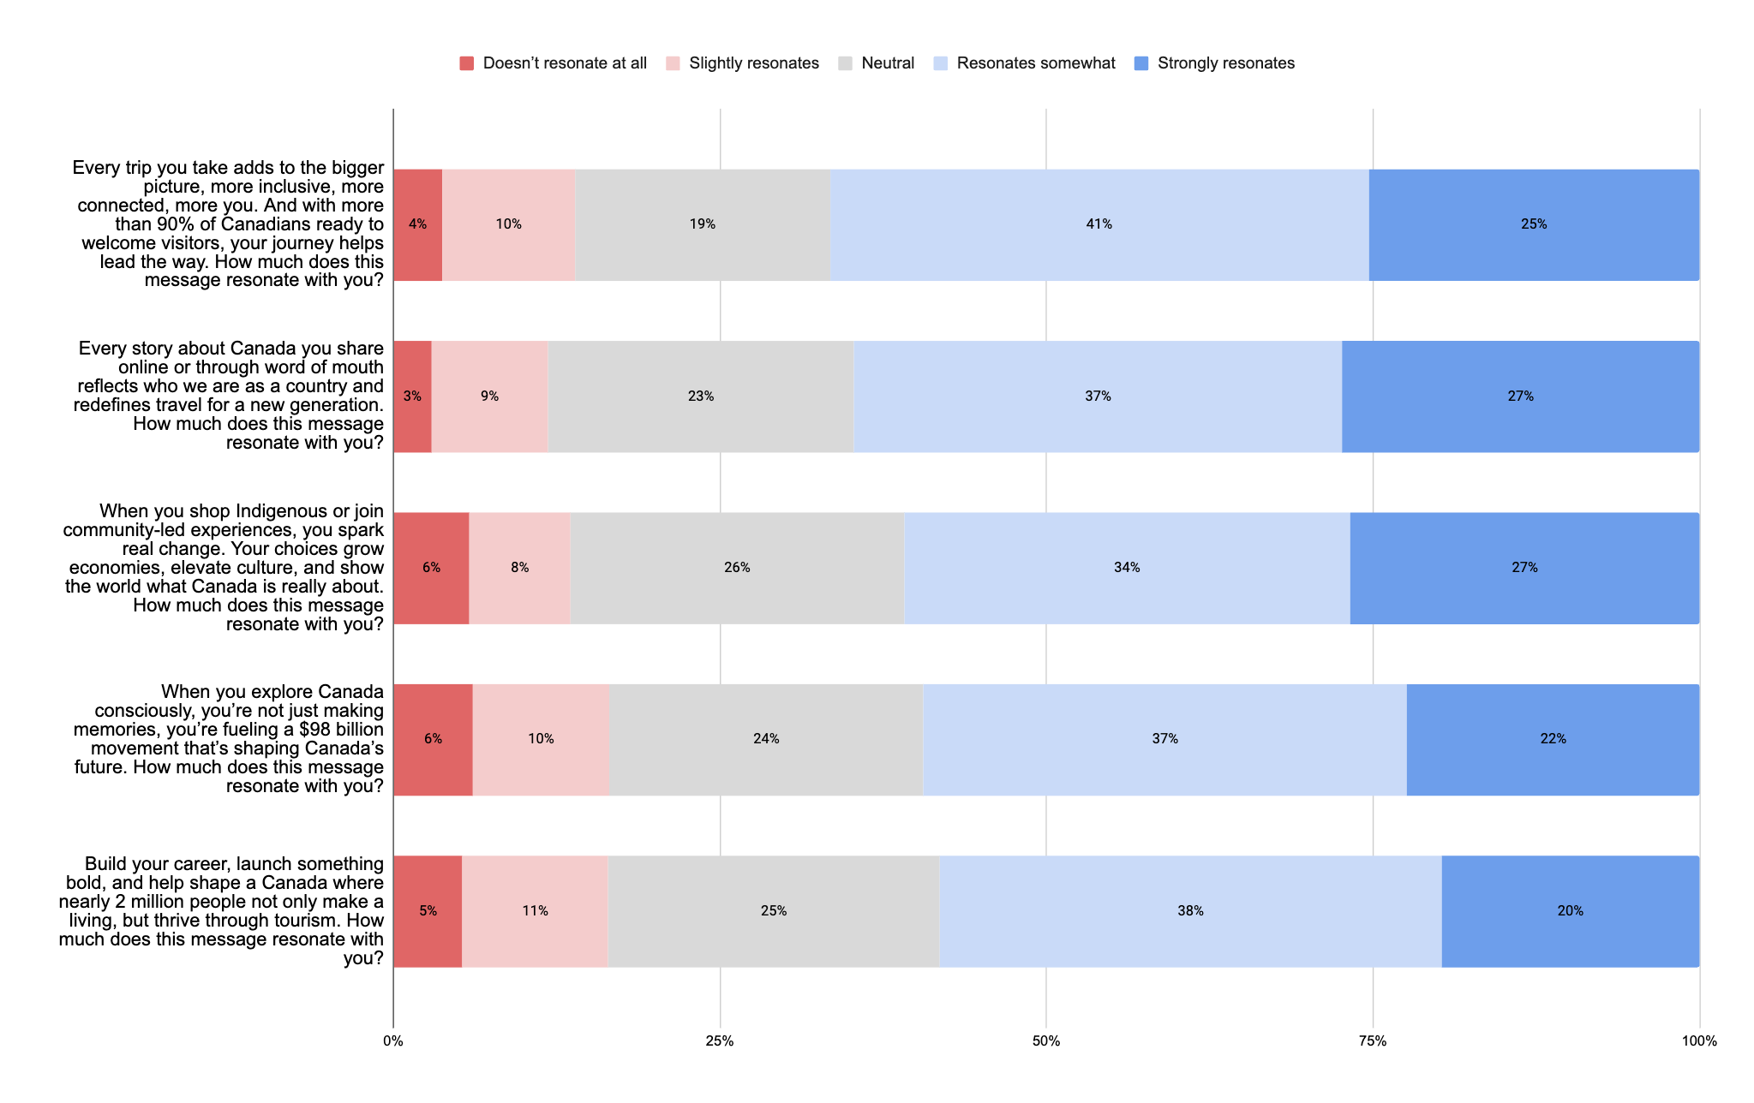
CANADIANS ≤40
Key Messages
Canadian Market Survey, Canadians <40(n=600), Resonance

Slide 64
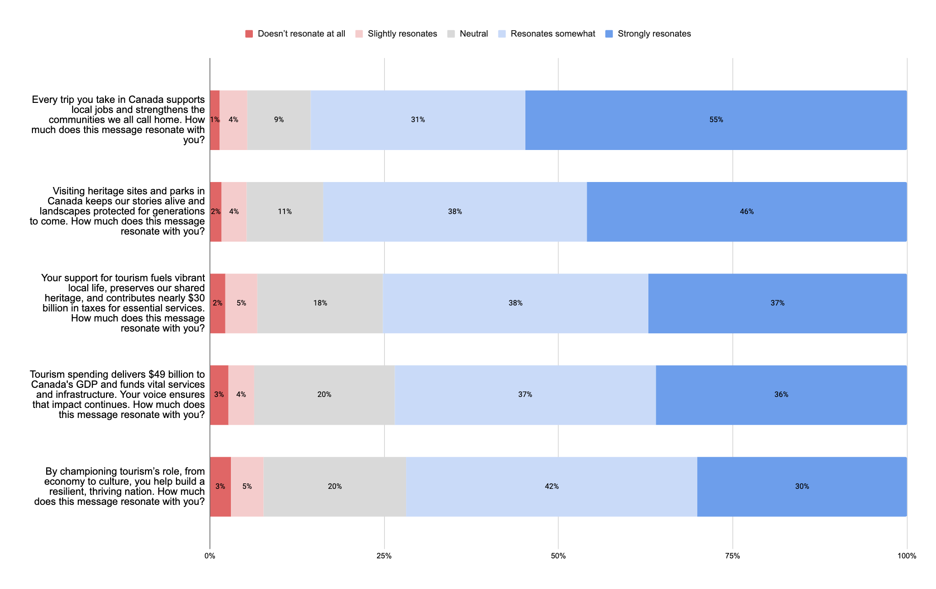
CANADIANS 40+
Key Messages
Canadian Market Survey, Canadians 40+ (n=600), Resonance

